Slide 1
IEEE 802.15.1
Bluetooth

Slide 2
Introduction
Wireless technology for short-range voice and data communication
Low-cost and low-power
Provides a communication platform between a wide range of “smart” devices
Not limited to “line of sight” communication

Slide 3
Introduction
Designed to allow low-bandwidth wireless connections
Ericsson, Intel, IBM, Nokia, and Toshiba started this in 1998 by establishing a Bluetooth special-interest group.
In December 1999, many companies, including 3COM, Lucent, Motorola, and Microsoft, joined in an attempt to evolve a reliable universal link for short-range RF communication.

Slide 4
Introduction
It is widely recognized that as time progresses, the number of short wires connecting computer peripherals has been increasing day by day.
Low-cost, low-power, radio-based wireless links eliminate the need for short cables.
An infrared link can easily provide speeds up to 10 Mbps at very low cost and ease of installation, but it requires line of sight and offers only a point-to-point link.
Hence, the concept of Bluetooth evolved to provide a universal standard for short-range RF communication of both voice and data.

Slide 5
Introduction
The ultimate goal is to make computers (PCs/laptops) have only one wire attached to them, which is the power cord, and make a portable computer truly portable.
In the case of a PDA, the power cord is also eliminated.
Communication protocols between two computers in a conference room environment do exist for Bluetooth.
However, the demands placed on the network by the voice and data traffic are different; multimedia traffic is likely to use most of the asynchronous real-time interactive data.
These packets consume nearly one-third of bandwidth in traditional peer-to-peer networks and much more in connections involving peripherals.
Any of the existing transport protocols cannot be used in this scenario and efficient protocols to handle this general situation need to be developed.

Slide 6
Introduction
Bluetooth utilizes the unlicensed ISM band at 2.4 GHz.
A typical Bluetooth device has a range of about 10 meters.
The communication channel supports data(asynchronous) and voice (synchronous) with a total bandwidth of 1 Mbps.
The synchronous voice channels are provided using circuit switching (slot reservation at fixed intervals).
The asynchronous data channels are provided using packet switching utilizing a polling access scheme.

Slide 7
Introduction
A combined data-voice packet is also defined to provide 64 kbps voice and 64 kbps data in each direction.
The time slots can be reserved for synchronous packets with a frequency hop for each transmitted packet.
A packet usually covers a single time slot but can be extended to cover up to five slots.
The Bluetooth specification defines two power levels:
a low-power level that covers a small personal area within a room and
a high-power level that can cover a medium range, such as an area within a home.

Slide 8
Characteristics
Software controls and identity coding built into each microchip ensure that only those units preset by their owners can communicate with the following characteristics:
Fast frequency hopping to minimize interference
Adaptive output power to minimize interference
Short data packets to maximize capacity
Fast acknowledgments allowing low coding overhead for links
CVSD (continuous variable slope delta) modulation voice coding, which can withstand high bit-error rates
Flexible packet types that support a wide application range
Transmission and reception interface tailored to minimize power consumption

Slide 9
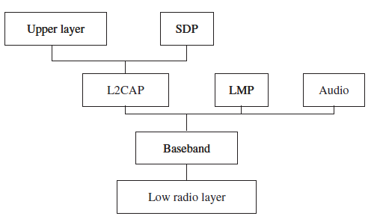
Bluetooth core protocols

Slide 10
Bluetooth core protocols
Service discovery protocol (SDP) provides a means for applications to discover which services are provided by or are available through a Bluetooth device.
Logical link control and adaptation layer protocol (L2CAP) supports higher-level protocol multiplexing, packet segmentation, and reassembly, and the conveying of quality of service information.
Link manager protocol (LMP) is used by the link managers (on either side) for link setup and control.
The baseband and link control layer enables the physical RF link between Bluetooth units forming a piconet.
It provides two different kinds of physical links with their corresponding baseband packets, SCO (Synchronous connection-oriented) and ACL(Asynchronous Connection-Less ), which can be transmitted in a multiplexing manner on the same RF link.

Slide 11
SCO (Synchronous connection-oriented)
Each link type supports up to 16 different packet types.
Four of these are control packets which are common for both SCO and ACL links.
Both link types use a TDD scheme for full-duplex transmissions.
The SCO link is symmetric and typically supports time-bounded voice traffic.
SCO packets are transmitted over reserved intervals.
Once the connection is established, both master and slave units may send SCO packet types and allow both voice and data transmissions—with only the data portion being retransmitted when corrupted

Slide 12
ACL(Asynchronous Connection-Less)
The ACL link is packet oriented and supports both symmetric and asymmetric traffic.
The master unit controls the link bandwidth and decides how much piconet bandwidth is given to each slave and the symmetry of the traffic.
Slaves must be polled before they can transmit data.
The ACL link also supports broadcast messages from the master to all slaves in the piconet.
There are three error-correction schemes defined for Bluetooth baseband controllers:
1/3 rate FEC
2/3 rate FEC
ARQ scheme for data

Slide 13
Architecture of the Bluetooth System
Bluetooth devices can interact with other Bluetooth devices in several ways.
One of the devices acts as the master and (up to) seven others as slaves and it is known as a piconet.
A single channel is shared among all devices in the piconet

Slide 14
Architecture of Bluetooth
Each of the active slaves has an assigned 3-bit active member address.
Many other slaves can remain synchronized to the master though remaining inactive slaves, referred to as parked nodes.
The master regulates channel access for all active nodes and parked nodes.
If two piconets are close to each other, they have overlapping coverage areas.
This scenario, in which nodes of two piconets intermingle, is called a scatternet.
Slaves in one piconet can participate in another piconet as either a master or slave through time division multiplexing.

Slide 15
Architecture of Bluetooth
In a scatternet, the two (or more) piconets are not synchronized in either time or frequency.
Each of the piconets operates in its own frequency hopping channel, and any devices in multiple piconets participate at the appropriate time via time division multiplexing.
Before any connections in a piconet are created, all devices are in STANDBY mode, where unconnected units periodically “listen” for messages every 1.28 seconds.
Each time a device wakes up, it tunes on the set of 32 hop frequencies defined for that unit.
Piconet supports both point-to-point and point-to-multipoint connections

Slide 16
Architecture of Bluetooth
The connection procedure for a piconet is initiated by any of the devices, which then becomes master of the created piconet.
A connection is made by sending a PAGE message if the address is already known,
Or
An INQUIRY message followed by a subsequent PAGE message if the address is unknown

Slide 17
Architecture of Bluetooth
In the PAGE state, the master unit sends a train of 16 identical messages using 16 different hop frequencies defined for the device to be paged (slave unit).
If it does not get any response, the master transmits a train on the remaining 16 hop frequencies.
The maximum delay before the master reaches the slave is twice the wake-up period (0.64 seconds).
A power-saving mode can be used for units in a piconet if there are no data to be transmitted.

Slide 18
Four Connected Modes
A Bluetooth device may assume any of four connected modes once a connection is present
Active mode
Hold mode
Sniff mode
Park mode
By changing modes Bluetooth devices can adjust the power, performance, and number of attached devices to the Piconet

Slide 19
Active Mode
Connected - Active
Connected-Active
Device E (Master)
Device B (Slave)
E
B
00
01
--
----
---
--
B
E
01
--
----
---
--
--
----
---
--
Device actively participates in the channel
Master allocates transmissions based on demands
Supports regular transmissions to keep maintain device synchronization
Limited to 7 devices
By the 3-bit Active Member Address

Slide 20
Active Mode
Connected - Active
Connected-Active
Device E (Master)
Device B (Slave)
E
B
00
01
--
----
---
--
B
E
01
--
----
---
--
--
----
---
--
5-slot transmission
3-slot transmission
Master
Slave
time
1-slot transmission
Notes:
This is a typical transmission sequence between master and slave devices that are in active mode.

Slide 21
Hold Mode
Connected - Active
Connected-Hold
Device E (Master)
Device B (Slave)
E
B
00
01
--
----
---
--
B
E
01
--
----
---
--
--
----
---
--
When Connected, the ACL link to a slave can be put in Hold mode
Slave temporarily does not support ACL packets
SCO links are still supported
Hold mode allows the slave to do other things like scanning, paging, inquiring, attending to other piconets, or simply sleeping
During Hold mode, the slave unit keeps its active member address (AMA)
Notes:
ACL- Asynchronous connection less
SCO- Sync Connection Oriented

Slide 22
Hold Mode
Connected - Active
Connected-Hold
Device E (Master)
Device B (Slave)
E
B
00
01 (AMA)
--
----
---
--
B
E
01
--
----
---
--
--
----
---
--
Before entering Hold mode the master and slave agree on the time duration for the hold period
A timer is initialized with the Hold timeout value
The slave returns to the Piconet when the timer expires
Slave synchronizes to the traffic on the channel
Slave waits for instructions from the master

Slide 23
Hold Mode
Connected - Active
Connected-Hold
Device E (Master)
Device B (Slave)
E
B
00
01 (AMA)
--
----
---
--
B
E
01
--
----
---
--
--
----
---
--
Slave waits for transmissions
from master
Slave wakes up
Master
Slave
T-hold
time
Notes:
Shown is a master putting a slave device on hold and after the hold time, T hold, the slave device wakes up.

Slide 24
Hold Mode
Connected - Active
Connected-Hold
Device E (Master)
Device B (Slave)
E
B
00
01 (AMA)
--
----
---
--
B
E
01
--
----
---
--
--
----
---
--
Slave waits for transmissions
from master
Master
Slave
T-hold
time
Active
Hold
Active
Notes:
Shown is a master putting a slave device on hold and after the hold time, T hold, the slave device wakes up.

Slide 25
Sniff Mode
Connected - Active
Connected-Sniff
Device E (Master)
Device B (Slave)
E
B
00
01
--
----
---
--
B
E
01
--
----
---
--
--
----
---
--
Sniff mode provides a connected slave a recurring series of free time
Master can only communicate during specified Sniff time slots
Sniff mode allows the slave to do other things like scanning, paging, inquiring, attending to other piconets, or simply sleeping
During Sniff mode, the slave unit keeps its active member address (AMA)

Slide 26
Sniff Mode
Connected - Active
Connected-Sniff
Device E (Master)
Device B (Slave)
E
B
00
01
--
----
---
--
B
E
01
--
----
---
--
--
----
---
--
Master
Slave
D-sniff
D-sniff
time
T-sniff
T-sniff
1 through N
Notes:
In the sniff mode, as shown, the slave listens to the master transmissions at predefined time slots, D sniff and T sniff.
This reduced listening mode enables the slave to attend to other tasks at hand.

Slide 27
Sniff Mode
Connected - Active
Connected-Sniff
Device E (Master)
Device B (Slave)
E
B
00
01
--
----
---
--
B
E
01
--
----
---
--
--
----
---
--
Master
Slave
D-sniff
D-sniff
time
Active
Active
T-sniff
T-sniff
1 through N
Notes:
In the sniff mode, as shown, the slave listens to the master transmissions at predefined time slots, D sniff and T sniff.
This reduced listening mode enables the slave to attend to other tasks at hand.

Slide 28
Park Mode
Connected - Active
Connected-Park
Device E (Master)
Device B (Slave)
E
B
00
001 (PMA)
002 (ARA)
--
----
---
--
B
E
01PMA
02 ARA
--
----
---
--
--
----
---
--
A Parked slave remains synchronized to the Piconet but does not actively participate
When Parked the Slave surrenders its Active Member Address for a Parked Member Address (PMA) and Access Request Address (ARA)
8-bits each (up to 255 Parked devices per Piconet)
The PMA and ARA are used for Master/Slave and Slave/Master communications at Beacon intervals

Slide 29
Park Mode
Connected - Active
Connected-Park
Device E (Master)
Device B (Slave)
E
B
00
001 (PMA)
002 (ARA)
--
----
---
--
B
E
01PMA
02 ARA
--
----
---
--
--
----
---
--
The Access Request Address (ARA) is used by the slave in a slave-initiated Unpark procedure.
All messages sent to Parked slaves are carried by broadcast packets (the all-zero AMA)
The Parked slave wakes up at a regular Beacon interval in order to maintain synchronization and to check for broadcast messages

Slide 30
Park Mode
Connected - Active
Connected-Park
Device E (Master)
Device B (Slave)
E
B
00
001 (PMA)
002 (ARA)
--
----
---
--
B
E
01PMA
02 ARA
--
----
---
--
--
----
---
--
Used to connect more than seven slaves to a single master.
Only seven active slaves can be connected at any one time.
By swapping Active and Parked slaves in and out of a piconet, the number of slaves connected can be much larger
Up to 7 Active slaves with 3-bit AMAs
Up to 255 Parked slaves with the 8-bit PMAs

Slide 31
Park Mode - Beacon Channel
The Beacon channel supports Piconet access of Parked slaves
The Beacon period is communicated to the slave when it is being Parked.
And can be changed at a Beacon interval
Beacon transmissions can extend over multiple Slots in a Beacon Train
Beacon Slots must have master-to-slave traffic
If there is no information to be sent null packets are transmitted by the master

Slide 32
Park Mode
Connected - Active
Connected-Park
Device E (Master)
Device B (Slave)
E
B
00
001 (PMA)
002 (ARA)
--
----
---
--
B
E
01PMA
--
----
---
--
02 ARA
--
----
---
--
Beacon Slots of a Beacon Train
Beacon Slots of a Beacon Train
Master
Slave
time
T-beacon
T-beacon
Active
Parked
Active
Notes:
Shown is a slave device being parked by the master device.
The parked slave does not have to wake up at every beacon instant. Instead, a sleep interval can be applied which is longer than and also a multiple of the beacon interval, T beacon.
By going into sleep for long periods of time, which are multiples of “T hold”, the device saves a lot of power.

Slide 33
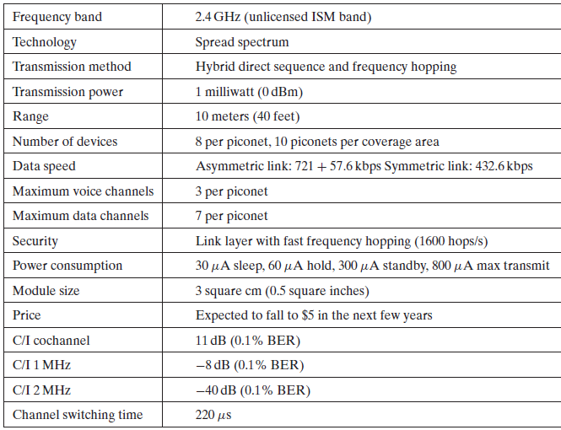
Bluetooth Technological Characteristics

Slide 34
Packet transmission in Bluetooth
A TDD scheme divides the channel into 625 μs slots at a 1 Mb/s symbol rate.
As a result, at most 625 bits can be transmitted in a single slot.
However, to change the Bluetooth device from transmit state to receive state and tune to the next frequency hop, a 259 μs turn around time is kept at the end of the last slot.
This results in reduction of effective bandwidth available for data transfer.

Slide 35
Packet transmission in Bluetooth
Bluetooth employs
HVx (high-quality voice) packets for SCO transmissions and
DMx (data medium-rate) or
DHx (data high-rate) packets for ACL data transmissions,
where x = 1, 3, or 5.
DMx and DHx, x represents the number of slots a packet occupies
HVx, it represents the level of forward error correction (FEC).
The purpose of the FEC scheme on the data payload is to reduce the number of retransmissions.
In the ARQ scheme, data transmitted in one slot are directly acknowledged by the recipient in the next slot, performing both the header error check and the cyclic redundancy check.

