Slide 1
EDGE AND EDGE+
BY
P.SAI LALITH ROHIT
132242601017

Slide 2
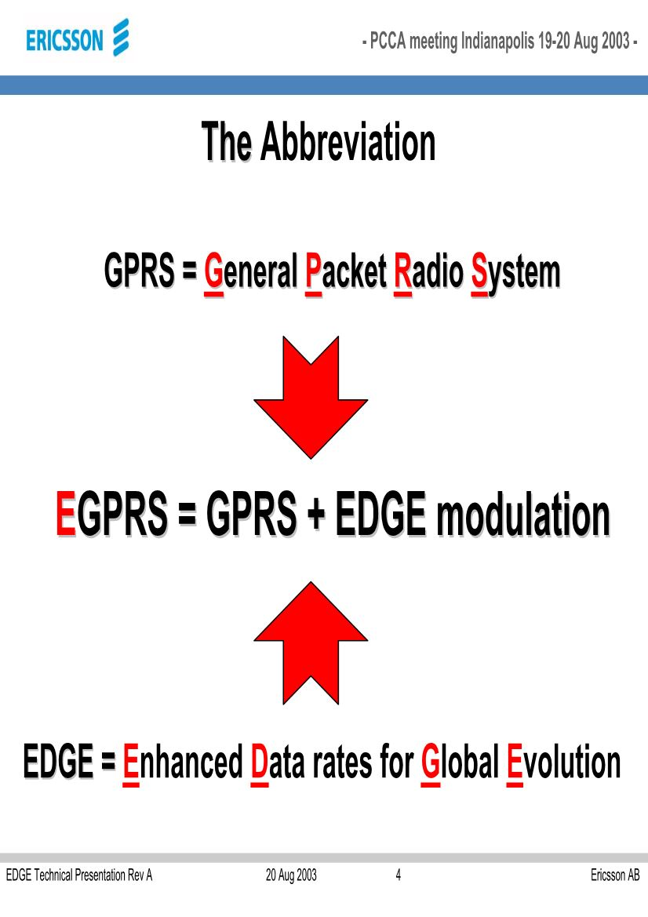

Slide 3
WHAT IS EDGE
IT Stands for ENHANCED DATA RATES FOR GSM EVOLUTION.
EDGE is a high speed mobile standard .this technology gives GSM the capacity to match the services offered by 3G network.
EDGE is considered as a 2.75 generation standard that is seen as a transition from 2G TO 3G.

Slide 4
It allows data transmission speeds up to 473.6 kbps.
The idea behind is to increase the data rate that can be achieved with GSM.
It works with existing GSM and GPRS NETWORK.
EDGE devices are backwards compatible with GPRS.
It also operates on GPRS networks where EDGE has not been deployed.

Slide 5
NECESSARY TECHNOLOGIES FOR IMPLEMENTING EDGE
GSM :
Largest mobile standard using today.
It enjoys world wide roaming.
GSM is implemented in 800MHz,900 MHz,1800 MHz and 1900 MHz frequency bands.

Slide 6
GPRS
An enhancement for GSM network that introduces packet data transmission.
GPRS uses radio spectrum very efficiently and users with “always on” connectivity and greater bandwidth.
GPRS delivers speeds upto 115kbps.

Slide 7
Problems in GPRS
In cellular system different users tend to have different channel qualities in terms of SIR(Ratio of the average received modulated carrier power to the average received co-channel interference power).
Services such as speech requires certain target SIR to give good quality below the target quality is unacceptable. While the above it is good.

Slide 8
The n/w has to make sure that only a small fraction of users are below the target .but large part of users experiences high SIR.
EDGE is designed to improve the situation by employing the mechanism known as link quality control.
Saturation GPRS saturates at low SIR, where as EDGE user quality increases with increased channel quality.
To obtain this EDGE must include transmission modes with significantly higher information bit rates than those of standard GSM.

Slide 9
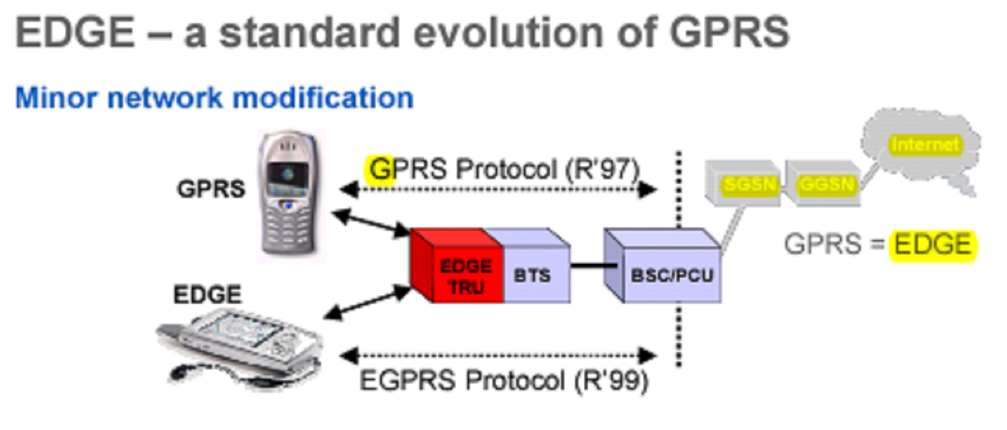

Slide 10
MAIN NEW NETWORK ARCHITECTURE ENTITIES NEEDED FOR EDGE
SGSN: (SERVING GPRS SUPPORT NODE)
This forms a gateway of services with in the network.
Provides services like packet routing and transfer ,authentication,logical link management ,charging data.
Stores location information.

Slide 11
2. GGSN: (GATEWAY GPRS SUPPORT NODE)
GGSN receives data addressed to a specific user ,it checks if the user is active, then forward the data.
Packet data from the mobile is routed to the right destination network by GGSN.

Slide 12
3. PCU: (PACKET CONTROL UNIT)
It differentiates data destined for the GSM network and data destined for the EDGE NETWORK.

Slide 13
MODULATION TECHNIQUES USED
GMSK and 8PSK modulation are used.
WHY GMSK USED:
GMSK high spectral efficiency.
It has constant power level which allows higher efficiency RF power amplifiers to be used in the handset, there by reducing current conserving battery life.
None of the information is carried as amplitude variations.

Slide 14
Drawbacks of GMSK
Gaussian filter increases the modulation memory in the system and cause inter symbol interference, making it more difficult between different transmitted data values and requiring more complex channel equalization algorithms.

Slide 15
8-PSK MODULATION:
In this modulation the information is conveyed on the phase of the carrier.
ADVANTAGES OF 8PSK:
Operates with in the with in the existing system GSM,GPRS CHANNEL STRUCTURE,BANDWIDTH,CODING STRUCTURE.

Slide 16
GMSK AND 8PSK WORK TOGETHER
PSK has equivalent bandwidth and adjacent channel interference levels to GMSK. This makes it possible to integrate EDGE channels into existing GSM /GPRS NETWORK.
When the signal is poor GMSK can be more effective than 8PSK and as a result the overall EDGE modulation scheme is the mixture of GMSK and 8PSK.

Slide 17
EDGE+
EDGE+ which works like a GPS Navigator.
THE GLOBAL LEADER IN SATELLITE NAVIGATION “GRAMIN INTERNATIONAL LTD” announced recently this EDGE PLUS technology is introducing in touring cyclists ,mountain bikers.
It helps to find the way.

