Slide 1
Frequency Bands
Prepared by,
J.Jayastree (132242601007)
M.Tech(COS)

Slide 2
Frequency Band:
Is a specific range of frequencies in the radio frequency (RF) spectrum.
Frequency bands are groupings of radio frequencies that are used by mobile networks to communicate with mobile phones.

Slide 3
Radio Frequency
Radio frequency (RF) is a rate of oscillation in the range of around 3 KHz to 300 GHz,
which corresponds to the frequency of radio waves, and the alternating current which carry radio signals

Slide 4
Frequency Allocation
Use of radio frequency bands of the electromagnetic spectrum is regulated by governments in most countries.
A number standards bodies work on standards for frequency allocation, which are:
International Telecommunication Union (ITU)
European Conference of Postal and Telecommunications Administrations (CEPT)
European Telecommunications Standards Institute(ETSI)
International Special Committee on Radio Interference (CISPR)

Slide 5
Frequency Allocation
These standards have assigned frequency bands in 3 types of allocation.
No one may transmit - Only used for radio astronomy
Anyone may transmit - Uses unlicensed frequency bands
Only the licensed user of that band may transmit - By frequency reuse

Slide 6
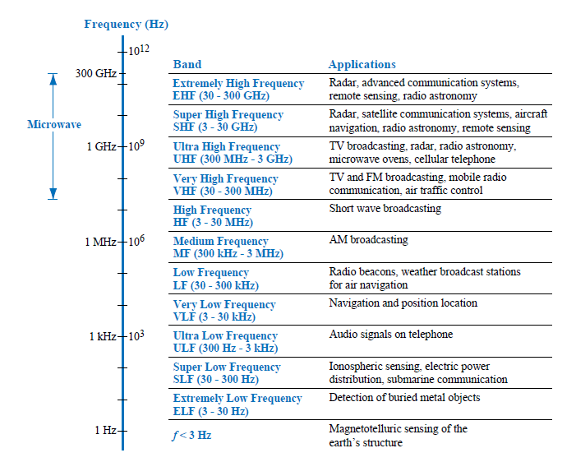
ITU Band

Slide 7
ITU Band
In ITU band ,frequency band number is allocated by , in which the number is the logarithm of the approximate geometric mean of the upper and lower band limits in Hz.
The ISM bands were first established at the International Telecommunications Conference of the ITU in Atlantic City, 1947

Slide 8
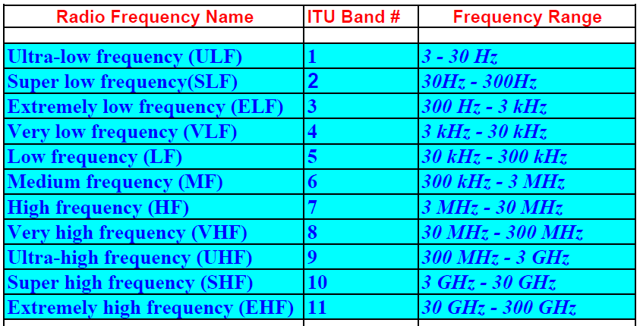
ITU Band

Slide 9
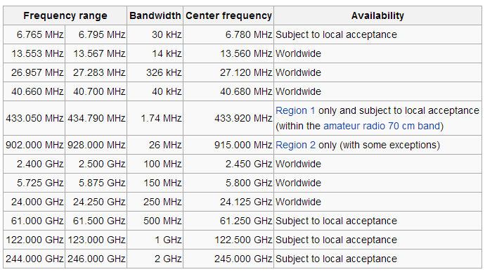
ISM Band

Slide 10
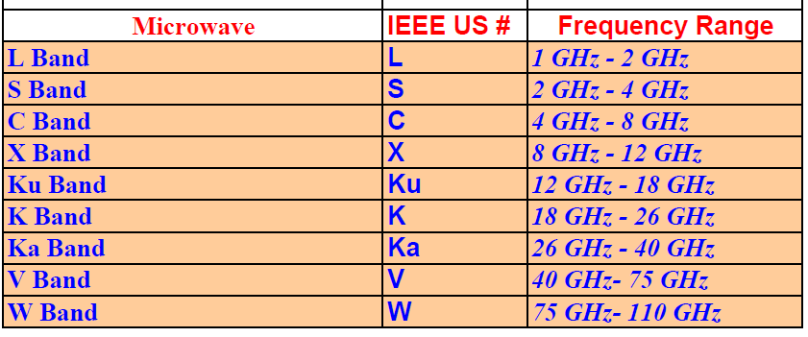
IEEE Bands

Slide 11
ELF
Extremely low frequency ranges from 3 to 30Hz
Wavelength ranges from 100,000 to 10,000Kms
ELF radio waves are generated by lightning and natural disturbances in Earth's magnetic field.
Used in submarines.

Slide 12
SLF
Super low frequency ranges from 30 to 300Hz.
Wavelength ranges from 10,000 to 1000Kms.
It penetrate sea water so used to communicate with sumarines.

Slide 13
ULF
Ultra Low Frequency ranges from 300Hz to 3KHz.
Wavelength ranges from 1000 to 100Kms
Used by military for secure communication through ground.

Slide 14
VLF
Very low frequency ranges from 3KHz to 30KHz.
Also known as myriametre band.
Wavelength ranges from 10 to 100Kms
VLF are used on radio navigation services, time radio stations,military communications.

Slide 15
LF
Low Frequency ranges from 30-300KHz.
Also known as kilometer band or kilometer wave.
Used in radio broadcasting,military etc.

Slide 16
MF
Medium frequency ranges from 300KHz to 3MHz.
Also known as hectometer band or hectometer wave.
It follows ground wave and sky wave propagation.
Used in RFD receivers.

Slide 17
HF
High frequency ranges from 3 to 30MHz.
Also known as decameter band or decameter wave.
Wavelength ranges from 1 to 10decameters.
Military and governmental communication systems, Aviation air-to-ground communications, Amateur radio

Slide 18
VHF
Very High Frequency ranges from 30 to 300MHz.
Wavelength ranges from 1 to 10 meters.
Commonly used in FM ,TV broadcast

Slide 19
UHF
Ultra High Frequency ranges from 300MHz and 3GHz.
Also known as decimeter band or decimeter wave.
Used in mobile communications, TV broadcasting.

Slide 20
SHF
Super High Frequency ranges from 3GHz to 30GHz.
Also Known as centimeter band or centimeter wave.
Wavelength ranges from 1 to 10Cms.
Used in radar,cell phones,Wlan etc.

Slide 21
EHF
Extremely high frequency ranges from 30 to 300GHz.
Also known as millimeter band or millimeter wave
Wavelength ranges from 30 to 300GHz.
Used in Telecommunication,weapon system,Medicine.

Slide 22
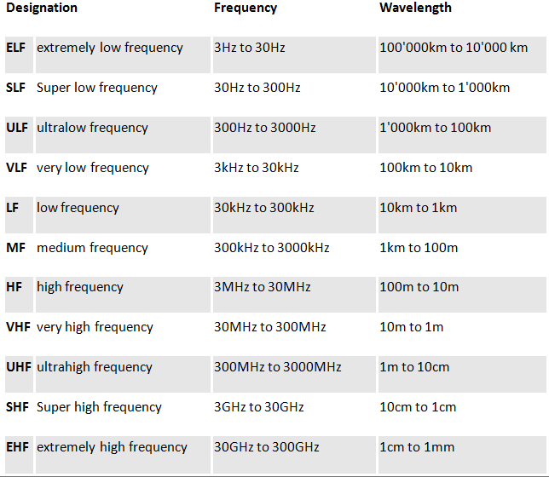
Frequency Bands

Slide 23
THANK YOU

