Slide 1
?????......

Slide 2
GAUSSIAN MINIMUM SHIFT KEYING (GMSK)
Presented by,
M.Mahamutha,
II yr,
M.Tech - COS
1

Slide 3
AGENDA
Introduction to GMSK.
Overview of MSK .
Generation of GMSK & its Waveform.
Pulse shaping.
Summing , Integration , I & Q signals.
GMSK Receiver
Power spectrum of GMSK
Properties.
Advantages.
Disadvantages.
2

Slide 4
INTRODUCTION TO GMSK
 Gaussian Minimum Shift Keying (GMSK) is a form of continuous-phase FSK in which the phase change is changed between symbols to provide a constant envelope. Consequently it is a popular alternative to QPSK.
 The RF bandwidth is controlled by the Gaussian low-pass filter. The degree of filtering is expressed by multiplying the filter 3dB bandwidth (B) by the bit period of the transmission (T), i.e. by BT (BT =
0.3 for GSM networks) .
 GMSK allows efficient class C non-linear amplifiers to be used.
3

Slide 5
INTRODUCTION TO GMSK (CONT….)
 Gaussian Minimum Shift Keying.
 Modulation scheme used in GSM.
 Bandwidth-time product.
Describes the amount the symbols overlap
BT = 0.3 for GSM networks
Good spectral efficiency
At the expense of some inter-symbol interference (ISI)
 Data rate: 270.8 kbps.
4

Slide 6
MSK
 GMSK is based on MSK.
 Minimum Shift Keying.
Linear phase changes
Spectrally efficient
 At baseband, bit transitions are represented by ½ sinusoidal cycle.
5

Slide 7
GENERATION OF GMSK
 It is similar to standard minimum-shift keying (MSK); however the digital data stream is first shaped with a Gaussian filter before being applied to a frequency modulator.
 This has the advantage of reducing sideband power, which in turn reduces out-of-band interference between signal carriers in adjacent frequency channels.
 However, the Gaussian filter increases the modulation memory in the system and causes intersymbol interference, making it more difficult to discriminate between different transmitted data values and requiring more complex channel equalization algorithms such as an adaptive equalizer at the receiver.

Slide 8
GENERATING A GMSK WAVEFORM
Gaussian Low Pass Filter
FM
transmitter
NRZ
Data
GMSK
Output at RF
H_{G}f = exp (-α²f²)
Where , α <=> B = 3 dB Bandwidth
= 0.5887/B
F = frequency in Hz.
GMSK as implemented by quadrature signal processing at baseband followed by a quadrature modulator
7

Slide 9
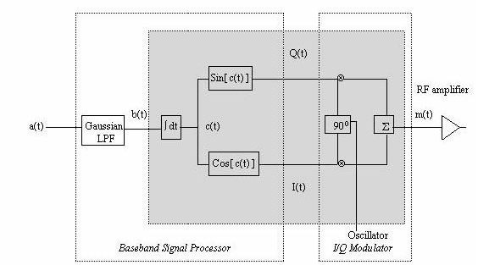
GENERATING A GMSK WAVEFORM (CONT….)
 GMSK as implemented by quadrature signal processing at baseband followed by a quadrature modulator
8

Slide 10
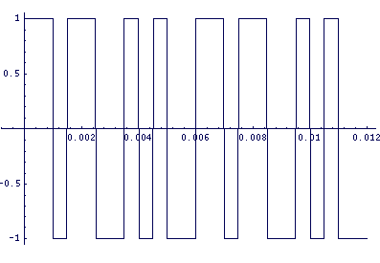
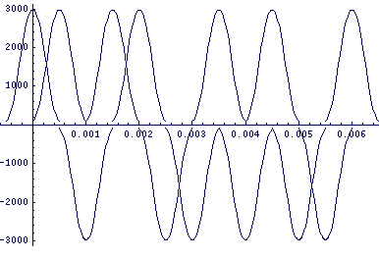
PULSE SHAPING
 Input: Binary pulse train (+1/-1).
 Each binary pulse goes through a LPF with a Gaussian impulse response.
The filter smoothes the binary pulses
The filter output is truncated and scaled
 This process results in a train of Gaussian shaped pulses

Slide 11
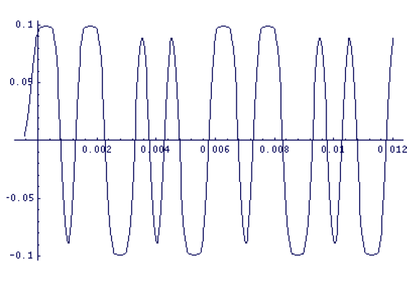
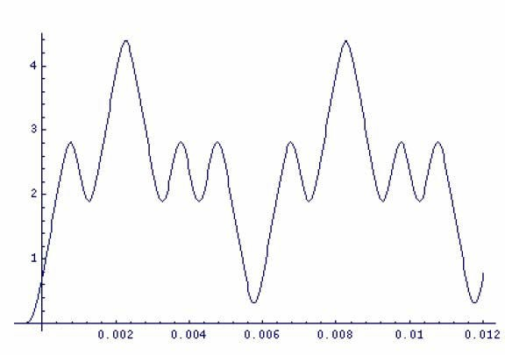
SUMMING AND INTEGRATION
 The pulses are summed together (left).
 The signal is integrated over time to obtain a continuous waveform which captures the bit transition information (right).

Slide 12
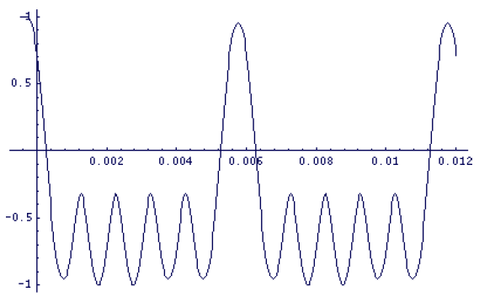
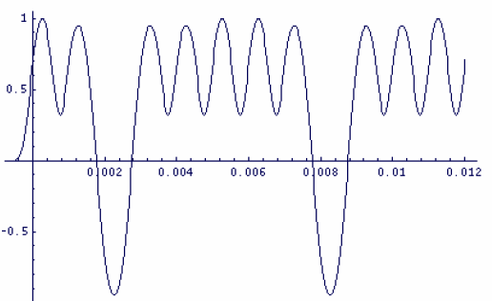
I&Q SIGNALS
 The resulting waveform is divided into In-Phase and Quadrature components.
In-phase: Left
Quadrature: Right
 The two signal components are then up-converted to the carrier frequency.

Slide 13
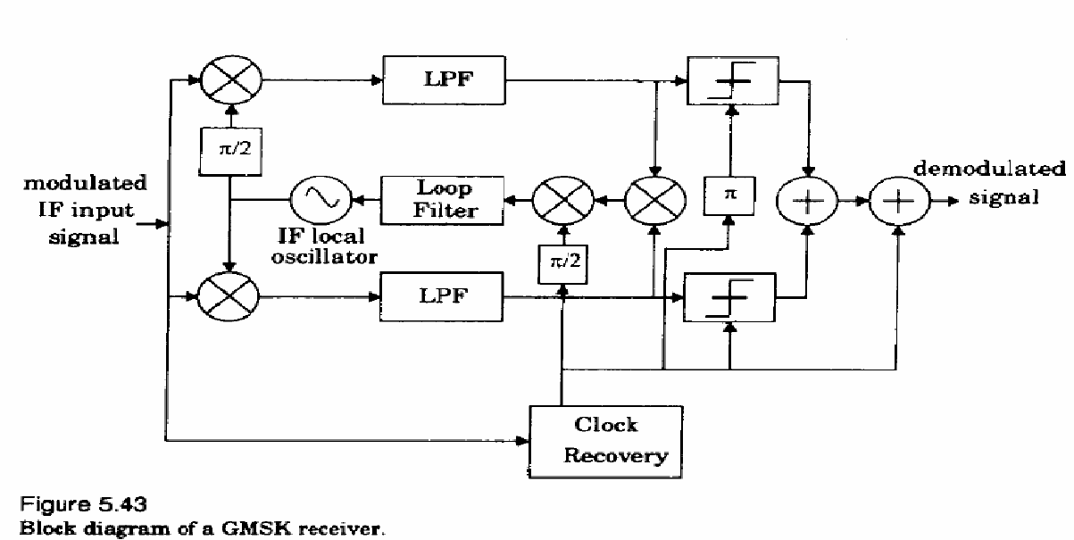
GMSK RECEIVER
 Two D flip-flops acts as a quadrature product demodulator generate mutually orthogonal ref careers.
 X-OR gates acts as a baseband multipliers.

Slide 14
GMSK PROPERTIES
 Improved spectral efficiency.
 Power Spectral Density.
Reduced main lobe over MSK
 Requires more power to transmit data than many comparable modulation schemes.
 Self synchronizing capability
 Constant envelope over entire B.W
 Good BER performance

Slide 15
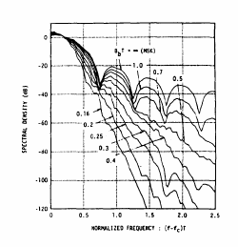
POWER SPECTRUM OF GMSK
BT Decreases , side lobe falls rapidly.
Gives more power (%) with BT of 0.5 = BT of MSK
14

Slide 16
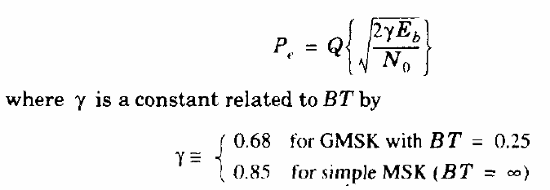
GMSK BIT ERROR RATE
 Function of BT.
 Bit error probability for GMSK is
15

Slide 17
ADVANTAGES
High spectral efficiency.
Reducing sideband power.
Excellent power efficiency due to constant envelope.
Good choice for voice modulation.

Slide 18
DISADVANTAGES
 Higher power level than QPSK.
 Requiring algorithms receiver.
more complex channel equalization such as an adaptive equalizer at the

Slide 19
APPLICATION
Most widely used in the Global System for Mobile Communications (GSM).
Used for CDPD (cellular digital packet data) overlay network.
Used for GPRS & EDGE systems.

Slide 20
Thank You
20

