Slide 1
IDENTITY NUMBERS
BY
A.M.VILLAVAN
M.TECH(COS)

Slide 2
RFID
Acronymn: Radio Frequency Identification Device
RFID is a technology, whose origins are found in the WWII era, that incorporates electromagnetic or electrostatic coupling in the RF portion of the EM spectrum to uniquely identify an object, animal or person.
Holds a small amount of unique data – a serial number or other unique attributes of the item
The data can be read from a distance – no contact or even line of sight necessary

Slide 3
CONT…
Radio Frequency Identification
The use of radio frequency tags to identify real objects.
Assign IDs to objects
Link the ID to additional information about the object
Link the ID to complementary info
Find similar objects

Slide 4
IDENTIFICATION EXAMPLES
Bar Codes
License Plates
Social Security Numbers
Student ID
Serial Numbers
Car Keys

Slide 5
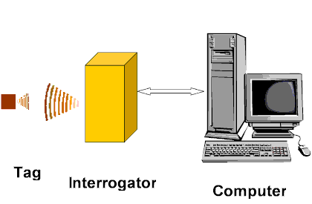
HOW DOES RF WORKS
3 Components
Transceiver – Tag Reader
Transponder – RFID tag
Antenna

Slide 6
Objects equipped with RFID tag
Tag contains transponder with digital memory chip.
Interrogator: an antenna packaged with transceiver and decoder.
emits signal activating tag.
Reader detects activation signal, decodes the data on the tag’s silicon chip.
Data passed to host computer.

Slide 7
RFID STANDARDS
Tracking Animals
ISO 11784 – Specifies the structure of the ID code
ISO 11785 – Specifies how transponder is activated
ISO 14223/1 – Specifies RF code for advanced transponders
Credit Cards
ISO 15693 – Specifies modulation and coding schemes
Passports and proximity cards
ISO 14443 – Specifies modulation and coding schemes
General Frequency bands
ISO 18000 series

Slide 8
FREQ RANGE OF RFID STANDARDS
ISO 18000-2
<135 KHz
ISO 18000-3
13.56 MHZ
ISO 18000-4
2.45 GHz
ISO 18000-6
860-960 MHz
ISO 18000-7
433 MHZ (active)

Slide 9
ACTIVE RFID TAG
Battery Powered tags
Have much greater range – 100m
Hold much more information – Kbytes
Can integrate sensing technology
Temperature, GPS
Can signal at defined time
Multiple tags can be recorded/read at once
Used for higher value items
Shipping containers
Electronic assets
Cost between $20 and $40 per item
Life between 2 – 4 years

Slide 10
PASSIVE RFID TAG
“Traditional” tags used in retail security applications
Tag contains an antenna, and a small chip that stores a small amount of data
Tag can be programmed at manufacture or on installation
Tag is powered by the high power electromagnetic field generated by the antennas – usually in doorways
The field allows the chip/antenna to reflect back an extremely weak signal containing the data
Collision Detection – recognition of multiple tags in the read range – is employed to separately read the individual tags

Slide 11
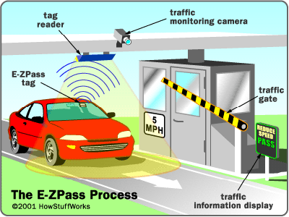
APPLICATIONS
Tracking Books in Libraries
Passports (US passports recently)
AmEx Blue credit card
Prison inmates (embedded)

Slide 12
CONT…..
For toll booths (or any “pay for entry” system)
Airport Baggage ID
Car keys, wireless entry and ignition
Animals
Hospital Patients
Instant history tracking

Slide 13
DISADVANTAGES
Cost
Transceiver ~ $1000
RFID Tags $0.20 each
Not competitive with cost of barcode
UHF signals problematic near metal and water
Reader Collisions
Can be overcome using TDMA
Tag Collisions
Required some engineering of tag transmit timing
Security Concerns

Slide 14
CONCLUSION
RFID technology is rapidly becoming more standardized, but problems do still exist
The number of adopters of RFID technology is growing
Regulation and education is necessary to quell some of the fears regarding RFID technology and it’s implications

Slide 15
THANK YOU

