Slide 1
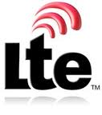
LTE- Long Term Evolution
Nancy. I
M. Tech- Cos
132242601012

Slide 2
Introduction
LTE is the latest standard in the mobile network technology tree that previously realized the GSM/EDGE and UMTS/HSxPA network technologies that now account for over 85% of all mobile subscribers.
LTE will ensure 3GPP’s competitive edge over other cellular technologies.

Slide 3
Agenda
Terminology
Background
What is LTE?
Goals of LTE
Key Factors of LTE
Other Key Factors of LTE
Service Advantages of LTE
Cost Advantages of LTE
Disadvantages of LTE
LTE market at a Glance
LTE Competitor & Future
Conclusion
References

Slide 4
Terms & Definition
3GPP : 3rd Generation Partnership Project.
A group of standard bodies produce technical specification for telecom industry.
GSM : Global system for mobile communication.
It is widely used mobile protocol.
CDMA : Code division multiple access.
GPRS :General Packet Radio Service.
SC-FDMA: Single Carrier-Frequency division multiple access.
TDMA : Time division multiple access.
OFDM: Orthogonal frequency division multiplexing.
MIMO: Multiple in multiple out.
IMS : IP multimedia subsystem.
SON : Self organizing networking.
VoIP : Voice over IP.
BW : Band width.
AMPS : Advanced Mobile Phone System
TACS :Telephone Access Customer Satisfaction
EDGE :Enhanced Data-rates for Global Evolution
HSDPA : High-Speed Downlink Packet Access
NMT :Network Management Tool
PSDN :Public Switched Telephone Network.
UMTS :Universal Mobile Telecommunications System.

Slide 5
Conti…
Modulation: A process of varying carrier signal.
Latency: Delay of packet data experienced in a system.
IPv6: Next generation Internet Protocol version 6.
QoS: Quality of Service is a better service methodology in data traffic.
Backhaul: A link/system between core network and distributed point.
Multicasting: Send a packet to multiple sites.
Spectrum: A range of frequencies is needed to transfer desired signal.

Slide 6
Background
Telecom standards are moving from one generation to another generation time to time. Updated generation is always presenting advanced capabilities and better services.
1G
2G -> 2.5G
3G
- Analog Mobile System
Small Size of Users
Voice only
Expensive
Big size of devices.
Standards:
AMPS, TACS, NMT
- Digital system
Big Size of Users
Voice and Data only
Enable Internet access
Moderate Data rate
Standards:
GSM (TDMA based), CDMA
Data network : GPRS, EDGE, IS95-B
- Voice, data and multimedia content
Faster data rate
Video telephony
Standards:
WCDMA, HSDPA (GSM based)
CDMA2000 (CDMA Based)
4G

Slide 7
What is LTE
It is assumed to be the successor of 2G and 3G.
It is also known as mobile broadband. Because:
It is optimized to all IP wireless network. Packet switch will be used, no circuit switch.
It’s target to transfer data is 100+ Mbps for uplink and 50+ Mbps for downlink.
It improves the existing services of current telecom.
It also enables new multimedia services to end users.
First proposal was given by NTT DoCoMo in 2004.Now it is tested and implemented successfully.

Slide 8
Conti…
LTE uses Orthogonal Frequency Division Multiple Access (OFDMA) on the downlink, which is well suited to achieve high peak data rates in high spectrum bandwidth.

Slide 9
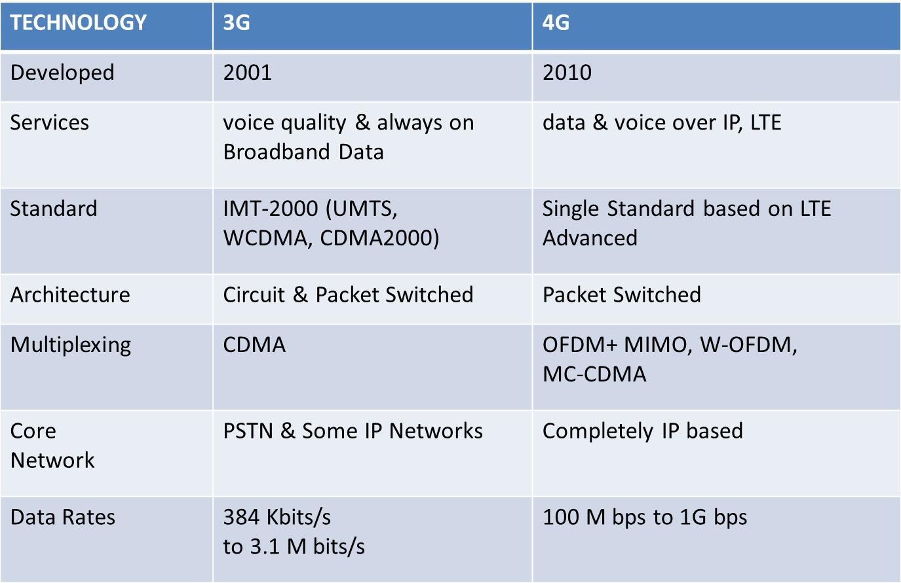
3G Vs 4G

Slide 10
LTE Goals Than Others
If we compare LTE with other (2G/3G), the significant goals are as follows:
The main goal is to transmit higher data rate in lower cost.
3G technology like HSDPA can provide
6-7 Mbps data where as LTE targets
100+ Mbps.
LTE targets to reduces latency as well as setup time than others.
Less than 10 MS in LTE where as in 3G it is almost 100 MS.
Simplified network architect.
It has fewer network components.
Migration path is easier and cost effective.
It also adjust the old network.
Fully packet switch.
Easier and automated System management.
LTE
100+ Mbps
3G
2+ Mbps
2.5G
144 Kbps
2G
14.4 Kbps
Downlink speed
2G
<700 MS
2.5G
<300 MS
3G
<100 MS
LTE
<10 MS
Latency

Slide 11
Key Factors of LTE
Technically, LTE has changed in access area network to achieve that great performance.
Radical change in Modulation technique.
LTE uses OFDM in downlink and SC-FDMA in uplink.
Those are totally different than TDMA in GSM and CDMA in 3G.
OFDM is very suitable to produce high data rate without distortion.
Picture shows that 50% frequency can be saved. it, is more complex.
Scalable bandwidth.
1.25 to 20 MHz where as 3G uses 5 MHz fixed channel. So theatrically LTE has four times more BW than 3G.
MIMO- a new innovation.
Idea is to use multiple smart antennas at both transmitter and receiver end.
Multiple signals can be propagated. Obviously it will increase the data throughput.
It also reduces the multi path interference problem.
Ch.
Ch.
Ch.
Ch.
Ch.5
Ch.
Ch.
Ch.
Ch.
Ch.
Conventional multicarrier techniques
Freq.
Ch.1
Ch.
Ch.3
Ch
Ch.5
Ch
Ch.7
Ch.
Ch.9
Ch.
50%
Bandwidth saving
Orthogonal multicarrier techniques OFDM
Freq.
Tx
Rx
MIMO Channel

Slide 12
Others key Factors of LTE
Basically 2G or 3G has two types of core network: Packet switch and circuit switch.
LTE reduces core into simplified one.
This is done by using IPv6 into core network. So there is no circuit switch.
Integrate of 2G 3G and LTE functions into a single node (Ex: Gate way).
Use standard and open protocol to provide multimedia services and applications.
Intelligent network management
Operation and maintenance of LTE is a self management system called SON.
Access
Packet
Circuit
Service
2G
IMS
Internet
&
Service
Domain
S
3G
S
LTE Gateway, controller
LTE
S
Management

Slide 13
Service Advantages of LTE
Advantages of higher data rate and low latency.
Fulfill the public’s demand in future data usages.
Provide multimedia content like music video etc clearly.
Online gaming or social networking via mobile.
Replace fixed broadband line.
Improved response time of a service.
More coverage in indoor and outdoor
Advantages of simplified core network.
Produce low cost-per-bit via all IP network.
Support all kind of backward network standards.
Up gradation from 2G/3G is smooth and easy.
Existing operator can take data service or data with voice service.
No need to replace existing site, cabinet, tower and power.
Enable multicasting, path optimization and better security.
Unbound roaming.
Advantages of automated network Management.
A set of tasks is automated.
Existing staffs are enough to operate.

Slide 14
Cost Advantages of LTE
Re-investment cost is low.
Reuse of current assets
Ex: no need to replace existing towers.
Fewer network components.
Reuse of existing allocated frequency.
Simplified migration and installation.
More Revenue than present.
Due to the high data rate, rich multimedia content can be served.
Ex: VoIP, Video conference etc.
New popular services to user.
End to end QoS services.
Network sharing.
Reduce Operational and Capital Expenditure by using SON.
Lowering human power during new hardware installation. It is just plug-n-play.
Reduce huge workload via network optimization like auto neighbor list, auto interference reduction etc.
Automatically save energy by powering off the equipment, if there is no service.
Auto fault detection and correction also reduce additional staff cost.
For end users.
More data in low cost.
No need additional broadband line.
Open new business arena.

Slide 15
Disadvantages of LTE
Technical Issues:
Evolving of LTE standards is so rapid that Vendors may not support constantly.
Some Verizon users experience low data rate due to the LTE network problem.
Additional spectrum may not available in many region.
LTE imposes IP based backhaul.
Some operators may not ensure the future demand if they not replace legacy network (EX: copper cable network).
To process more data in device, more power is needed.
Users already suffer poor battery life.
It also reduces the device long life.
Few manufacturer produces LTE supported devices.
User has less option to buy phone.
Business Issues:
If operator offers flat rate for user, it may not be profitable.
On the other hand, user may not interest to use high data traffic if no flat rate.
In some areas, operators have to invest huge money for new frequencies.
Some operators have to invest new backhaul.
LTE recommends to reduce cell size. So, investment cost will increase.
LTE supported devices’ price is still high.

Slide 16
LTE Market at a Glance
LTE market is very promising.
Already 20 LTE networks in 14 countries are commercially running.
154 operators in 60 countries are under process.
54 operators in 20 countries are doing feasibility.
Telecom giant like DoCoMo, KDDI, Verizon, AT&T, Vodafone, China telecom, Telstra, T-Mobile etc have already deployed LTE.
Ericsson is leading vendor in LTE equipment market. Beside this, Alcalet-Lucent, Nokia-siemens etc also accepted LTE.
Based on infonetics report, there is a chance of infrastructure market about 20,000 Billion Yen.
LTE subscribers will be 290 million by 2015 out of 700 million.

Slide 17
FUTURE OF LTE LTE-Advanced (LTE-A)
LTE-A shall have same or better performance than LTE
Peak data rate (peak spectrum efficiency)
- Downlink: 1 Gbps, Uplink: 500 Mbps
Peak spectrum efficiency
- Downlink: 30 bps/Hz, Uplink: 15 bps/Hz
Same requirements as LTE for mobility, coverage, synchronization, spectrum flexibility etc

Slide 18
APPLICATIONS
Mobile web access(3G, 4G)
Cloud computing
Gaming services
High-definition mobile TV
Video conferencing
3D television
IP telephony
mobile broadband, smartphones, tablets, Android, mobile video WiMAX,

Slide 19
Conclusion
From my observation, the patter of mobile devices have been changed radically.
The popularity of iPhone, iPad, Xperia, Galaxy tab etc has shown the new demand in future.
Basically in next generation standard users want cost effective high data rate.
On behalf of operator, they want a simple and open architecture to deploy and operate.
In the above point of view and discussion, LTE has fulfilled those and already taken a well position.
Service scope of LTE is not only mobile but also the others consumer electronics (Ex: Camera. Notebook etc.).
Due to it’s early and quick popularity, LTE will be the universal accepted standard very soon.

Slide 20
Thank you

