Slide 1
MODULE II Wireless Systems

Slide 2
Content
AMPS (Advanced Mobile Phone System)
Characteristics
Operation
General Working of AMPS Phone System
Global System for Mobile Communication
Frequency Bands and Channels
Frames
Identity Numbers
Layers, Planes and Interfaces of GSM
International Mobile Telecommunications (IMT-2000)
Spectrum Allocation
Services provided by 3G Cellular Systems
Harmonized 3G Systems
Universal Mobile Telecommunications Systems (UMTS)

Slide 3
AMPS (Advanced Mobile Phone System)
Characteristics
Operation
General Working of AMPS Phone System

Slide 4
AMPS (Advanced Mobile Phone System)
The first representative of wireless systems.
AMPS is the first cellular phone technology created by AT&T Bell Labs.
The idea was to divide the entire service area into logical divisions called cells.
Each cell is allocated one specific band in the frequency spectrum.

Slide 5
AMPS
To explore a reuse pattern, the frequency spectrum is divided among seven Cells improving the voice quality as each user is given a larger bandwidth.
Typically, AMPS uses a cell radius of 1 to 16 miles, depending on various factors such as density of users and traffic intensity.
However, there is a tradeoff between the cell area and the quality of service.
Larger cells tend to have more thermal noise and less interference, while smaller cells have more interference and less thermal noise.
One important aspect of AMPS is that it allows both cell sectoring and splitting.
It is also sufficient to have a low-power MS (about 4 watts or less) and a medium-power BS (about 100 watts).
AMPS is capable of supporting about 100,000 customers per city, and the system is aimed to reduce blocking probability to about 2% during busy hours.

Slide 6
Characteristics of AMPS
AMPS uses the frequency band from 824MHz to 849MHz for transmissions from MSs to the BS (reverse link or uplink) and
the frequency band between 869MHz to 894MHz from the BS to the MS (forward link or downlink).
The 3 kHz analog voice signal is modulated onto 30 kHz channels.
In transmitting data, the system uses Manchester frequency modulation at the rate of 10 kbps, while the control parameters remain the same as in voice transfer.
Separate channels are used for transmitting control information and data.
Since fewer control messages are exchanged between the MS and the BS as compared with voice or data messages, a smaller number of control channels are employed than voice antennas.
In AMPS, there is one control transreceiver for every eight voice transreceivers.

Slide 7
Band Allocation in AMPS
Frequency allocation in AMPS is done by dividing the entire frequency spectrum into two bands—Band A and Band B.
The non-wireline providers are given Band A
Bell wireline providers are given Band B.
A total of 666 channels (which was later increased to 832 channels) is divided among these two bands
A cluster of seven cells allows many users to employ the same frequency spectrum simultaneously.
It uses directional radio propagation which enables different frequencies to be transmitted in different directions, thereby reducing radio interference.

Slide 8
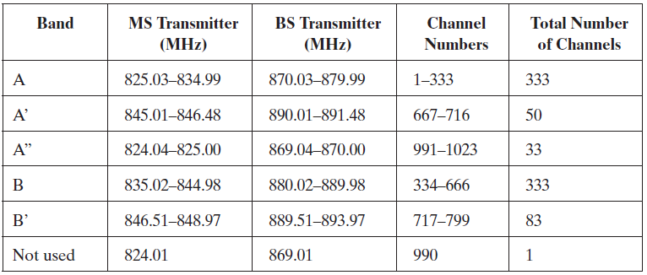
Band Allocation in AMPS

Slide 9
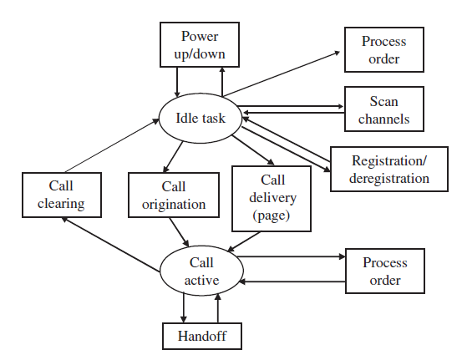
Operation of AMPS

Slide 10
Operation of AMPS
Three identification numbers are included in the AMPS system to perform various functions
1. Electronic serial number (ESN):
A 32-bit binary number uniquely identifies a cellular unit or a MS and is established by the manufacturer at the factory.
Since it is unique, any MS can be precisely identified by this number.
For security reasons, this number should not be alterable and should be present in all MSs.
2. System identification number (SID):
A unique 15-bit binary number assigned to a cellular system.
The Federal Communications Commission (FCC) assigns one SID to every cellular system, which is used by all MSs registered in the service region.
A MS should first transmit this number before any call can be handled.
The SID serves as a check and can be used in determining if a particular MS is registered in the same system or if it is just roaming.
3. Mobile identification number (MIN):
A digital representation of the MS’s 10-digit directory telephone number.

Slide 11
How does a MS know when it receives a call?
The location of a particular MS is not predictable.
The answer lies in the messages passed on the control channels.
Whenever the MS is not in service, it tunes to the strongest channel to find out useful control information.
The same happens at the BS as well.
There are two important control channels:
forward control channel (FOCC) from the BS to the MS, and
reverse control channel (RECC) from MS to BS, both operating at 10 kbps
Various channels used by the AMPS are as follows:

Slide 12
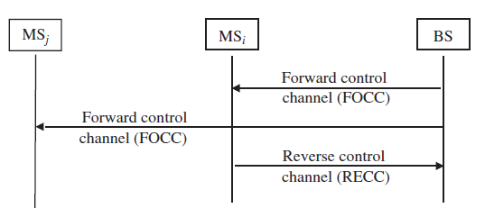
Forward and reverse channels

Slide 13
Forward control channel (FOCC)
FOCC is used primarily by the BS to page and locate the MSs using the control information in three-way time division multiplexing mode.
The busy/idle status shows if the RECC is busy, and stream A and stream B allow all the MSs to listen to the BS.
Stream A is for MSs having least significant bit (LSB) of MIN as zero
Stream B is for those MSs with LSB of MIN as one.
As a part of control information, BS also allocates voice channels to MSs.

Slide 14
Forward control channel (FOCC)
Each data frame consists of several components,
starting with a dotting sequence (alternating 1s and 0s),
continues with a word-sync pattern,
followed by five repeats of word-A and word-B data.
The BS forms each word by encoding 28 content bits into a (40,28) BCH code.

Slide 15
FOCC frame format
The first busy/idle bits are inserted at the beginning of the dotting sequence.
The second is inserted at the beginning of the word sync, and
The third is inserted at the end of the word sync.
After the third busy/idle bit, a busy/idle bit is inserted every 10 bits through the five repeats of word-A and word-B data.
The busy/idle bits indicate the control channel availability with the BS.
An idle-to-busy transition coordinates messages sent on the control channel.

Slide 16
Reverse control channel (RECC)
Control for the reverse direction is little involved as this information comes from one or more MSs using the RECC channel.
This could also be in response to the page sent by the BS.
There could be several MSs responding to queries.
A simple mechanism to indicate whether RECC is busy or idle is to model it after the slotted ALOHA packet radio channel.

Slide 17
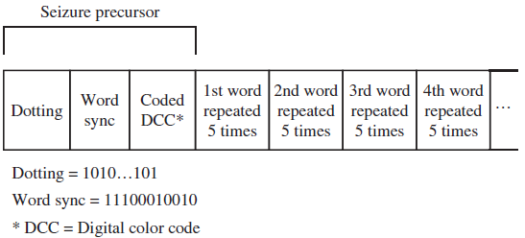
Format of RECC
Begins with the RECC seizure precursor of 30 bits of dotting, 11 bits of word sync, and the 7-bit coded digital color code (DCC).
DCC is primarily used to detect if any co-channel interference is occurring in the specified region.
For a single-word transmission following the seizure precursor, a single RECC message word repeats itself five times.
The seizure precursor fields are used for synchronization and identification.
For a multiple-word transmission following the seizure precursor, the first RECC message word repeats itself five times;
then the second RECC message word is repeated five times.

Slide 18
Forward voice channel (FVC)
FVC is used for one-to-one communication from the BS to each individual MS.
A limited number of messages can be sent on this channel.
A 101-bit dotting pattern represents the beginning of the frame.
The forward channel supports two different tones
continuous supervisory audio, in which the BS transmits beacon signals to check for the live MSs in the service area, and
discontinuous data stream, which is used by the BS to send orders or new voice channel assignments to the MS.

Slide 19
Reverse voice channel (RVC)
Reverse voice channel is used for one-to-one communication from the MS to the BS during calls in progress
Assigned by the BS to a MS for its exclusive use.

Slide 20
General Working of AMPS Phone System
When a BS powers up, it has to know its surroundings before providing any service to the MSs.
Thus, it scans all the control channels and tunes itself to the strongest channel.
Then it sends its system parameters to all the MSs present in its service area.
Each MS updates its SID and establishes its paging channels only if its SID matches the one transmitted by the BS.
Then the MS goes into the idle state, responding only to the beacon and page signals.

Slide 21
General Working of AMPS Phone System
If a call is placed to a MS, the BS locates the MS through the IS-41 message exchanges .
Then the BS pages the MS with an order.
If the MS is active, it responds to the page with its MIN, ESN, and so on.
The BS then sends the control information necessary for the call, for which the MS has to confirm with a supervisory audio tone (SAT), indicating completion of a call.
If a call is to be placed from a MS, the MS first sends the origination message to the BS on the control channel.
The BS passes this to the IS-41 and sends the necessary control signals and orders to the MS.
Thereafter, both MS and BS shift to the voice channels.
A FVC and RVC control message exchange follows to confirm the channel allocation.
Then the actual conversation starts.
Notes:
Assignment on IS41

Slide 22
Global System for Mobile Communication
Frequency Bands and Channels
Frames
Identity Numbers
Layers, Planes and Interfaces of GSM

Slide 23
Global System for Mobile Communication
GSM (Global System for Mobile communications or Groupe Speciale Mobile) communications, initiated by the European Commission,
It is the second-generation mobile cellular system
It is aimed at developing a Europe-wide digital cellular system.
GSM was created in 1982 operating at 900 MHz.
The main objective of GSM is to remove any incompatibility among the systems by allowing the roaming phenomenon for any cell phone.
It also supports speech transmissions between MSs, emergency calls, and digital data transmissions.

Slide 24
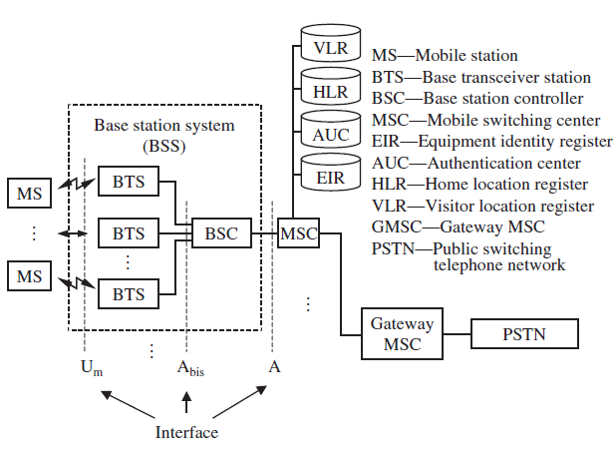
GSM infrastructure

Slide 25
Base station controller (BSC):
The main function of the BSC is to look over a certain number of BTSs to ensure proper operation.
It takes care of handoff from one BTS to the other
Maintains appropriate power levels of the signal
administers frequency among BTSs.

Slide 26
Mobile switching center (MSC)
Performs the switching functions of the system by controlling calls to and from other telephone and data systems.
It also does functions such as network interfacing and common channel signaling.
If the MSC has an interface to the PSTN, then it is called a gateway MSC.
GSM uses two important databases called HLR and VLR, to keep track of the current location of a MS.

Slide 27
Authentication center (AUC):
Provides authentication and encryption parameters that verify the user’s identity and
Ensure the confidentiality of each call.
It protects network operators from different types of frauds and spoofing found in today’s cellular world.

Slide 28
Equipment identity register (EIR)
It is a database that contains information about the identity of mobile equipment that prevents calls from being stolen and
Prevents unauthorized or defective MSs.
Both AUC and EIR can be implemented as individual stand-alone nodes or as a combined AUC/EIR node.

Slide 29
Frequency Bands and Channels
GSM has been allocated an operational frequency from 890MHz to 960 MHz.
MSs employ 890MHz to 915MHz
BS operates in 935MHz to 960 MHz.
GSM follows FDMA and allows up to 124 MSs to be serviced at the same time

Slide 30
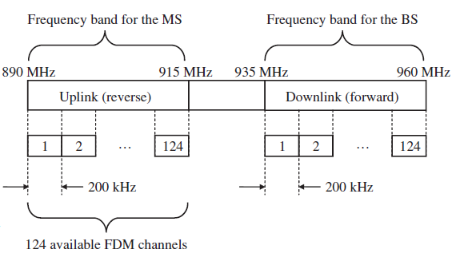
Frequency band used by GSM
The frequency band of 25MHz is divided into 124 frequency division multiplexing (FDM) channels, each of 200 kHz
A guard frame of 8.25 bits is used in between any two frames transmitted either by the BS or the MS.

Slide 31
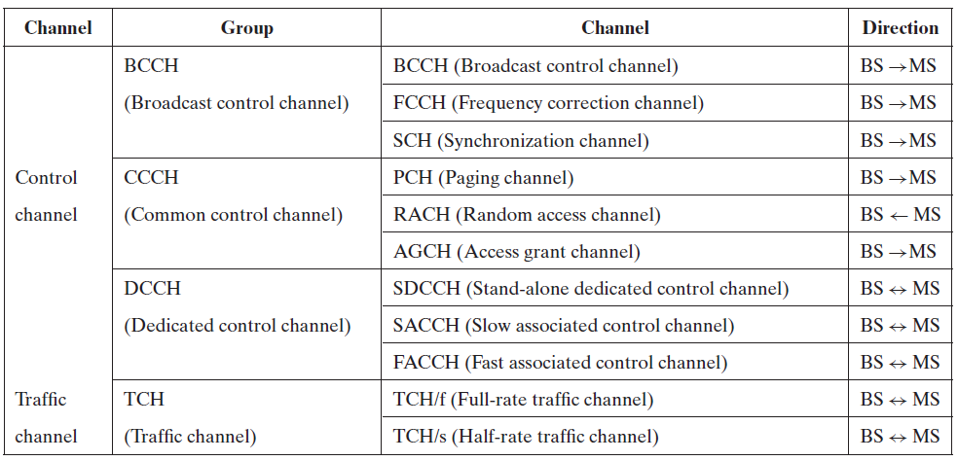
Channels in GSM

Slide 32
Channels in GSM
Three control channels are used for broadcasting some information to all MSs:
Broadcast control channel (BCCH): Used for transmitting system parameters, (e.g., the frequency of operation in the cell, operator identifiers) to all the MSs.
Frequency correction channel (FCCH): Used for transmission of frequency references and frequency correction burst of 148 bits length.
Synchronization channel (SCH): Used to provide the synchronization training sequences burst of 64 bits length to the MSs.

Slide 33
Channels in GSM
Three common control channels are used for establishing links between the MS and the BS, as well as for any ongoing call management:
Random-access channel (RACH): Used by the MS to transmit information regarding the requested dedicated channel from GSM.
Paging channel: Used by the BS to communicate with individual MS in the cell.
Access-grant channel: Used by the BS to send information about timing and synchronization.

Slide 34
Channels in GSM
Two dedicated control channels are used along with traffic channels to serve for any control information transmission during actual communication:
Slow associated control channel (SACCH): Allocated along with a user channel, for transmission of control information during the actual transmission.
Stand-alone dedicated control channel (SDCCH): Allocated with SACCH; used for transfer of signaling information between the BS and the MS.
Fast associated control channel (FACCH): FACCH is not a dedicated channel but carries the same information as SDCCH.
However, FACCH is a part of the traffic channel, while SDCCH is a part of the control channel.
To facilitate FACCH to steal certain bursts from the traffic channel, there are 2 bits, called the flag bits in the message.

Slide 35
Frames in GSM
The GSM system uses the TDMA scheme with a 4.615 ms– long frame, divided into eight time slots each of 0.557 ms.
Each frame measured in terms of time is 156.25 bits long, of which 8.25 period bits are guard bits for protection.
The 148 bits are used to transmit the information.
Delimited by tail bits (consisting of 0s), the frame contains 26 training bits sandwiched between two bursts of data bits.
These training bits allow the receiver to synchronize itself.
Many such frames are combined to constitute multiframe, superframe, and hyperframes.

Slide 36
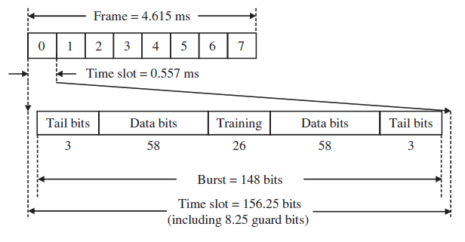
Frames in GSM

Slide 37
Identity Numbers Used by a GSM System
International mobile subscriber identity (IMSI)
Subscriber identity module (SIM)
Mobile system ISDN (MSISDN)
Location area identity (LAI)
International MS equipment identity (IMSEI)
MS roaming number (MSRN)
Temporary mobile subscriber identity (TMSI)

Slide 38
International mobile subscriber identity (IMSI)
When a cell phone attempts a call, it needs to contact a BS.
The BS can offer its service only if it identifies the cell phone (MS) as a valid subscriber.
For this, the MS needs to store certain values uniquely defined for the MS, like the country of subscription, network type,and subscriber ID, and so on.
These values are called the international mobile subscriber identity (IMSI).
This number is usually 15 digits or less.

Slide 39
International mobile subscriber identity (IMSI)
The first three digits specify the country code,
The next two specify the network provider code,
The rest specify the mobile subscriber identification code (the customer ID number).
Another use of IMSI is to find the information about the subscriber’s home public land mobile network (PLMN).
All such information is placed on a subscriber identity module (SIM), also known as a SIM card.

Slide 40
Subscriber identity module (SIM):
Every time the MS has to communicate with a BS, it must correctly identify itself.
A MS does this by storing the phone number (or the number used to contact the MS), personal identification number for the station, authentication parameters, and so on in the SIM card.
Smart SIM cards also have a flash memory that can be used to store small messages sent to the unit.
The main advantage of SIM is that it supports roaming with or without a cell phone, also called SIM roaming.
All a person needs to do is carry the card, and he or she can insert it into any phone to make it work as his or her customized MS.
In other words, the SIM card is the heart of a GSM phone, and the MS is unusable without it.

Slide 41
Mobile system ISDN (MSISDN)
MSISDN is the number that identifies a particular MS’s subscriber
Unlike other standards, GSM actually does not identify a particular cell phone, but a particular HLR.
It is the responsibility of the HLR to contact the cell phone.

Slide 42
Location area identity (LAI)
The GSM service area is usually divided into a hierarchical structure that facilitates the system to access any MS quickly, irrespective of whether it is in home agent territory or roaming.
Each PLMN is divided into many MSCs.
Each MSC typically contains a VLR to tell the system if a particular cell phone is roaming,
If it is roaming, the VLR of the MSC, in which the cell phone is, reflects that fact.
Each MSC is divided into many location areas (LAs).
A LA is a cell or a group of cells and is useful when the MS is roaming in a different cell but the same LA.
Since any LA has to be identified as the part of the hierarchical structure, the identifier should contain the country code, the mobile network code, and the LA code.

Slide 43
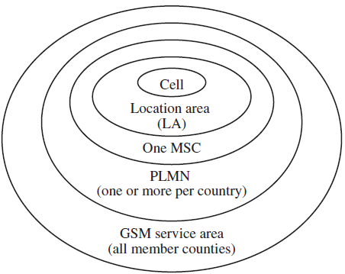
GSM layout

Slide 44
International MS equipment identity (IMSEI)
Each manufactured GSM unit is assigned a 15-bit long identification number to contain manufacturing information,
Conceptually, when the unit passes the interoperability tests, it is assigned a type approval code (TAC).
Since a single unit may not be manufactured at the same place, a field in IMSEI, called the final assembly code (FAC), identifies the final assembly place of the unit.
To identify uniquely a unit manufactured, a serial number (SNR) is assigned.
A spare digit is available to allow further assignment depending on requirements.

Slide 45
MS roaming number (MSRN)
When a MS roams into another MSC, that unit has to be identified based on the numbering scheme format used in that MSC.
Hence, the MS is given a temporary roaming number called the MS roaming number (MSRN).
This MSRN is stored by the HLR, and any calls coming to that MS are rerouted to the cell where the MS is currently located.

Slide 46
Temporary mobile subscriber identity (TMSI)
As all transmission is sent through the air interface, there is a constant threat to the security of information sent.
A temporary identity is usually sent in place of IMSEI.

Slide 47
Interfaces, Planes, and Layers of GSM
In a cellular network, possible interfaces are air interface U_{m} between MS and BTS;
interface A_{bis} between BSC and BTS; interface A between BSC and MSC; and
MAP (mobile application part), which defines operation between the MSC and the telephone network

Slide 48
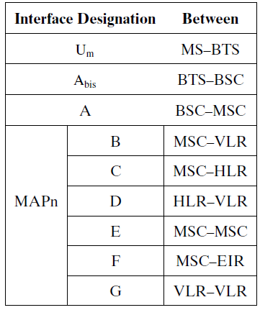
Interfaces of GSM

Slide 49
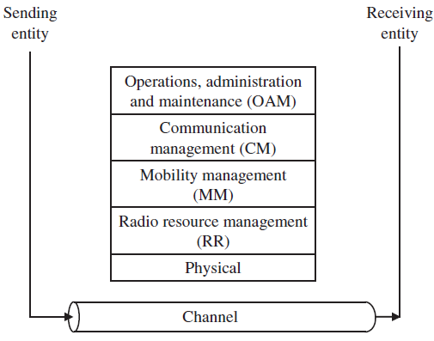
Planes
GSM system can be divided into five planes, as shown here

Slide 50
Planes
The physical plane
It provides the means to carry user information (speech or data) on all segments along the communication path and to carry signaling messages between entities .
Radio resource management (RR)
It establishes and releases stable connections between MSs and a MSC and maintains them despite user movements.
They are mainly performed by the MS and the BSC.
Mobility management (MM)
Functions are handled by the MS (or SIM), the HLR/AUC, and the MSC/VLR.
These also include management of security functions.
Communication management (CM)
It is used to set up calls between users and maintain and release resources.
It includes supplementary services management and short message management.
Operation, administration, and maintenance (OAM)
It enables the operator to monitor and control the system at any time.

Slide 51
Operation
For a MS to operate in a MSC, it must be registered by accessing the BSS,
which allocates the channels,
after authenticating the MS by
accessing the VLR through the MS’s HLR.
The MSC then assigns a TMSI to the MS and updates the VLR and HLR.

Slide 52
Operation
After getting the information from the home HLR of the MS the packets travel through the gateway MSC to the terminating MSC (the place where the MS is located).
Then the MS is contacted through the BSS, where the MS is roaming.
If it is the same MSC, there is no problem.
But if it is not, then the VLR of the current MSC contacts the HLR of the MS’s home MSC, which notifies the prior MSC about relocation of the MS.
Hence these three registers are updated with the new information.

Slide 53
Operation
Authentication in GSM is done with the help of a fixed network that is used to compare the IMSI of the MS reliably
When the MS asks for any request, the fixed network sends it a random number,
It also uses an authentication algorithm to encrypt with the IMSI and the key stored in its memory.
In the MS, the received random number is encrypted using IMSI,
The same key is transmitted to the fixed network, which compares it with the original value sent by the fixed network.
If they match, then the MS is authentic.

Slide 54
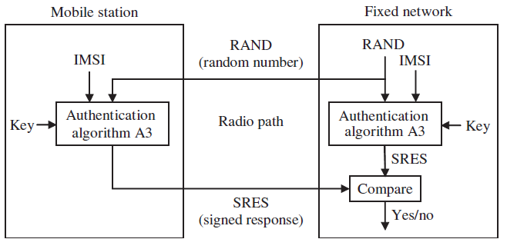
Authentication process in GSM

Slide 55
Assignment topics
IS 41(3 members)
PCS (3 members)
IS 95 (3 members)
Hand off in GSM and SMS (3 members)
International Mobile Telecommunications (IMT-2000) (7 members)
Universal Mobile Telecommunications Systems (UMTS) (5 members)

Slide 56
Thank you

