Slide 1
Physical layer for IEEE 802.11 wireless LANs: Radio systems

Slide 2
Introduction
Two specifications for radio :
The FH-SS physical layer and
the DS-SS physical layer.
Both employ radio transmission spectrum bands 2.4 GHz.
Unlicensed spectrum usage
Ex. ISM (industrial, scien- tific, and medical)
Problems must be solved by private agreements

Slide 3
Solution
Transmission power was limited to 10 mW or 100 mW.
In 1985, the FCC (Federal Communications Commission) established tight limits in the transmission power spectral density
The use of spread spectrum systems was promoted
The greater the band, the greater the transmission power.
The new rules, included regulations for direct sequence (DS) and frequency hopping (FH) systems.
Thus 802.11 PHY radio systems was evolved with 2.4-GHz ISM band

Slide 4
Physical layer

Slide 5
Contents
Spread spectrum techniques
Frequency hopping techniques
Direct sequence systems (DSS)
Codes in DSS
Transmission and reception in DSS
Performance in DSS

Slide 6
Spread spectrum techniques
Spread spectrum systems use more bandwidth than that needed for transmission.
Modulation format is necessary to determine the bandwidth
It uses a code in the transmitter,
independent of the data,
prior to modulation,
that must be known by the receiver to achieve a larger bandwidth.
A receiver unaware of the code would be unable to decode the transmitted data.
spectrum transmissions are more difficult to detect, intercept, or decode.
Was used initially in military and latter in commercial applications

Slide 7
Spread spectrum techniques
There are no differences between narrowband and spread spectrum systems in noisy environments.
The most frequently used spread spectrum techniques are FH and DS.

Slide 8
FREQUENCY HOPPING TECHNIQUES
FH systems use conventional modulation techniques,
But the carrier frequency is changed at a given rate, following a given sequence.
This sequence is the code of these systems.
A receiver must know the code to detect the datas.
If the hopping rate is faster than the bit rate, the system is fast FH (FFH).
If the hopping rate is slower than the bit rate, the system is slow FH (SFH).
Commercial systems are always SFH because of the complexity of FFH systems.

Slide 9
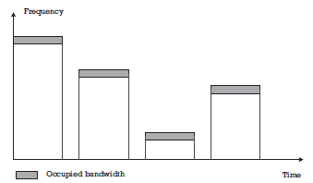
Frequency hopping techniques
Within a given burst, the transmission is narrowband, using just the bandwidth needed according to the bit rate and the modulation format.

Slide 10
Advantages in FH systems
In an interference environment, there are two, described as follows
Case 1: narrowband interfering transmitter:
the interference affects only those bursts whose carrier coincides with the carrier of the other transmitter.
Interference with other narrowband systems is mitigated by the fact that the transmission does not always occupy the same bandwidth.
The interference only occurs at times.
Case 2: If two FH systems working on the same band have overlapping coverage areas, interference will occur every time the bursts of both systems coincide in the same carrier.

Slide 11
Advantages in FH systems
When the signal arrives at the receiver through different paths, with different delays, frequency-selective fading occurs:
Some frequencies become heavily attenuated because of the destructive combination of the signals coming from different paths.
As the resulting phase differences depend on the carrier frequency, for other frequencies the combination is not destructive and can even be constructive, reinforcing the received power.
In an FH system some bursts would suffer from fading, but others would be received perfectly.
In a multipath propagation environment, only some bursts are affected by frequency- selective fading.

Slide 12
Frequency hopping techniques
As a consequence, these systems usually assume that
some of the bursts are received with very low quality (high BER) or
are completely lost because of propagation impairments or
because of a powerful interfering signal.
However, this affects only a small percentage of the trans- mission and can be recovered, either by forward error coding or by retransmissions.
FH systems are usually considered to work on a pass-fail basis.
Some bursts are received perfectly, and others are lost.
The system works as long as the rate of lost bursts is small

Slide 13
Frequency hopping techniques
This can be achieved in two ways:
Fight against interference.
Higher the number of available frequencies, the smaller the number of lost bursts.
This is true if the spectrum is not greatly used.
To limit the probability that many of them are simultaneously affected by fades.
channel correlation bandwidth: the amount of frequency displacement for which there is a high probability that fades occur at the same time.
If the system bandwidth is much larger than the channel correlation bandwidth the FH system will tolerate selective fading with few problems

Slide 14
Coherence correlation bandwidth
The coherence correlation bandwidth is roughly inversely proportional to the rms delay spread,
which is a measure of the difference between the time of arrival of the first and the last significant components of the signal.
An estimation of the coherence bandwidth B_{e} = 1/(2πD),
where D is the root mean squared (rms) delay spread.
Very small in outdoor mountainous areas, with different rays traveling very different distances.
Very large in indoor environments, where the distance differences are measured in meters and delay spreads in nanoseconds.
In median rooms rms delay spread has been measured to be in the range of 25-50 ns.
The coherence band- width would be between 3 and 6 MHz.
Larger rooms would show larger delay spreads and smaller coherence bandwidths.

Slide 15
Frequency hopping techniques
It is clear that FH systems are not appropriate when the spectrum is heavily used.
Most of the channels must be free.
However, this is not a problem in unlicensed bands.
As there is neither frequency planning nor user control unlicensed frequency bands are never used as much as licensed ones
No matter which transmission system is selected.

Slide 16
Frequency hopping techniques
When frequency use is more important, as in licensed bands, orthogonal FH can be used.
This is a technique that allows a group of transmitters to use the same frequency band, all of them with FH, but with their hop sequences tightly synchronized
This is used in GSM.

Slide 17
Frequency hopping techniques
If two independent FH transmitters that are working in unlicensed bands, the interference between them will occur when their frequencies coincide.
On average 1/N of the bursts would be lost,
N being the number of available frequencies.
As the hop times would not be synchronized, the number of lost bursts would be between 1/N and 2/N on average.
The greater the number of frequencies, the higher the level of protection against interference.
As N increases, the bandwidth also increases.
In fact, N can be regarded as the ratio between the bandwidths for the spread spectrum system Bss and the narrowband one Bnb.
N =Bss/ Bnb

Slide 18
Frequency hopping techniques
FH employ frequency modulation, BPSK and QPSK
FH transmitters and receivers have to rapidly change the carrier frequency.
The switching time will be lost for transmission and thus has to be made as small as possible.
It has to be very small compared to the length of the burst.
Hop rates in commercial systems usually are between 1 and 300 hops per second.

Slide 19
Frequency hopping techniques
Challenge
The receivers have to synchronize their frequency hop sequence.
Unless some kind of centralized control informs all the nodes of the times to hop, the receiver must usually spend a considerable amount of time to acquire synchronism.

Slide 20
DIRECT SEQUENCE SYSTEMS
The modulation rate is intentionally increased to spread the spectrum.
This is achieved by combining the bit sequence with a higher- rate binary sequence (called the chip sequence) to obtain a new sequence with chip rate
This one is then used to modulate the carrier.
The inverse operation is performed at the receiver side.
The signal is demodulated, and then it is recombined with the same chip sequence to restore the original data.

Slide 21
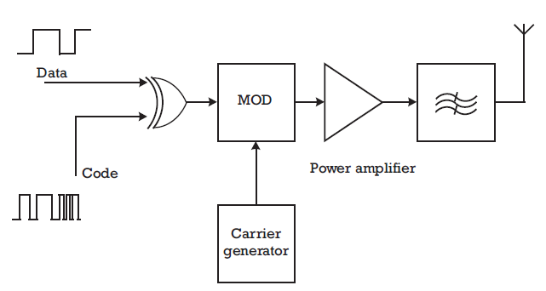
Basic direct sequence transmitter

Slide 22
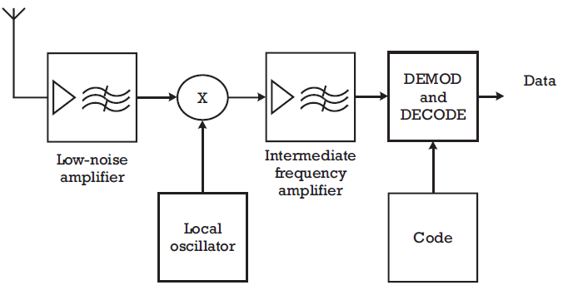
Direct sequence receiver

Slide 23
Real challenge
Practical implementations require further considerations on
the kind of chip sequences used, and
ways to combine them with the data sequence,
modulation formats employed,
techniques to demodulate the signal,
synchronization issues, and
data recoverers.

Slide 24
Advantages of DS compared to narrowband systems
The power spectral density, (measured in power per unit of bandwidth) is much lower because of the larger bandwidth over which the power is spread.
low probability of interception
lower capacity of interfering with other systems.
2. Includes privacy to the communication since chip sequence are used.
DS receivers present a certain degree of noise rejection and interference since signal bandwidth is reduced and filtered.
Can share the same spectrum with direct sequence communications, if uncorrelated chip sequence are used.

Slide 25
Codes in direct sequence systems
Codes are always periodic, but their period can be
as short as a symbol period, or
as long as several thousands of symbols or
even more.
Short codes facilitate the gaining of synchronism in the receiver,
Long codes are needed to guarantee the privacy of the communications.

Slide 26
Codes in direct sequence systems
There are two characteristics that are met by all the codes used in DS systems:
Balanced codes, with roughly the same number of 0s and 1s.
These are needed to avoid the presence of a DC component.
Pseudo- random sequences with roughly equal probabilities of appearance of both symbols (‘0's and ‘1's) are very often used, particularly in long codes.

Slide 27
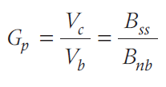
Codes in direct sequence systems
Because the chip rate is always a multiple of the bit rate, in a bit period there is an integer number of chips.
Both sequences are synchronized.
This reduces the amount of high-frequency energy that would appear if a transition in the bit sequence were followed shortly afterward by a transition in the chip sequence.
The ratio of the chip rate (Vc) over the bit rate (Vb) is called the processing gain (Gp);
It is also equal to the ratio of the spread spectrum system bandwidth (Bss) to the bandwidth of a narrowband system (Bnb) with the same bit rate.
It influences all the system's performance.

Slide 28
Classification of codes
Orthogonal,
Quasi-orthogonal, and
Uncorrelated
This classification can also be applied to systems, according to the type of codes used.

Slide 29
Orthogonal codes
These are codes whose correlation with codes of the same family is exactly zero.
This is a very good property, since different users using these codes can share the same frequency band with zero interference among them.
This property is only met when the codes are combined with the same time reference.
Even small displacements between the time origin of codes leads to an uncontrolled amount of interference.
The system must maintain perfect synchronism at the chip level among all users.
Usually employed for the transmission from a central node to different remote receivers.
As the signals are generated in the same transmitter, there is no difficulty in synchronizing them at chip level.
One example of orthogonal codes is the Walsh sequences used in the IS-95 cellular system

Slide 30
Quasi-orthogonal codes
These are codes that, while keeping
a very small level of correlation when combined in phase,
can tolerate displacements to some degree with no significant degradation in their mutual interference.
A synchronization system is needed which can maintain alignment of the received signals during a few chip intervals.
Some subsets of Gold codes have this property and are used in CDMA satellite communications

Slide 31
Uncorrelated codes
It present low levels of correlation with one another, for any time displacement.
They are used when no time synchronization between different users is performed by the system.
Different users employ different codes, and the interference with each other is kept small on average, with only occasional peaks that would lead to bit errors.
Examples of uncorrelated codes are maximal length codes and Gold codes

Slide 32
Summary of codes
Orthogonal and quasi-orthogonal codes are usually short codes, as this facilitates the synchronization of all the signals.
They are obtained from tables in the transmitter and receiver.
Uncorrelated codes are usually long codes.
It limits the level of correlation between different codes
It enlarges the time between interference peaks.
They are usually obtained from pseudorandom generators.
This technique is the same used in data scramblers, or in cryptography systems.

Slide 33
Transmission and reception in direct sequence systems
The combination of the chip sequence with the bit sequence is usually made by addition (mod. 2) with an XOR gate.
Several modulation formats can be used.
One possibility is an I-Q modulation, such as BPSK or QPSK.
QPSK has the advantage that it spreads the power further between the two orthogonal carriers with the same frequency (sine and cosine components).
This improves the performance of the system in the presence of narrowband interference signals.
BPSK is easier to implement and has a higher immunity to noise.
Some systems use BPSK for the data and QPSK for the spreading sequences to combine the advantages of both modulation formats.

Slide 34
DS transmitter
Practical implementation can vary depending on
how much processing is made in digital form and
how much is analog processing and
whether the modulation is made on the RF frequency or in an intermediate frequency.
A frequency converter that transforms the signal to RF and delivers it to the power amplifier follows the modulator.
The transmitter structure is quite similar to a digital transmitter working at the chip rate, whose data input signal is the combination of data and chip sequences.

Slide 35
DS receiver
DS receivers are not at all digital receivers working at the chip rate, followed by a despread module.
Individual chips need not be detected in a DS receiver, and
A receiver designed to detect them would present a degraded threshold, because it would have to cope with all the noise and perturbations present in the spread spectrum bandwidth.

Slide 36
DS receiver
The signal is first down-converted and pass-band filtered within its RF bandwidth.
This is the spread spectrum bandwidth Bss.
The filtered signal is then XOR-combined with the code.
Subsequently, it is filtered with the narrowband bandwidth Bnw.
As this is smaller than Bss in the processing gain Gp, noise and perturbations are rejected in this proportion.
Next the signal is conceptually identical to a signal received in a narrow- band system;
It undergoes the usual operations of carrier and clock synchronization and detection.

Slide 37
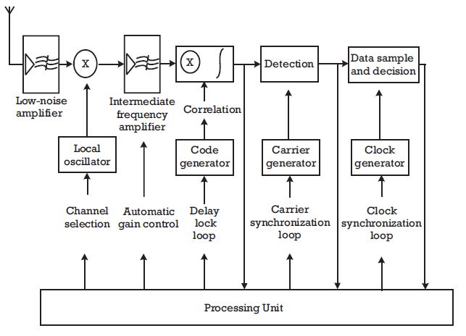
DS receiver

Slide 38
DS receiver
Direct sequence receiver is the need for synchronization of the code with the received signal.
This is performed with a local code generator controlled by a local clock. (VCO).
When the code is in phase with the one used in the transmitted signals, higher levels are detected in the correlated output.
The power detected at this point is filtered and fed back to control the VCO frequency.
The structure is very much like a phase lock loop, but as the controlled variable is the delay between the transmission and reception codes, it is called a delay lock loop (DLL).
Key Strategies for designing DS receiver
combining the operations of code,
carrier
clock synchronization
automatic gain control.

Slide 39
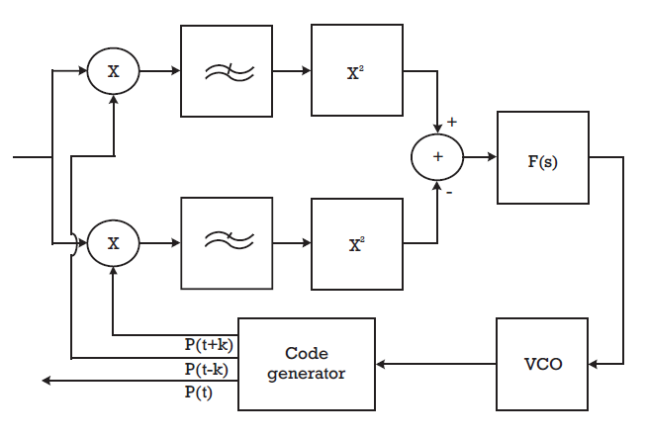
DLL

Slide 40
Performance in direct sequence systems
The process of filtering the signal within the spread spectrum bandwidth,
combining it with the code, and
further filtering within the narrowband bandwidth affects all the signals present in the system, including the noise, by reducing its power by roughly the process gain. It can be shown that:

Slide 41
Performance in direct sequence systems
The approximation becomes equality for interferences having a low degree of correlation with the signal.
This includes other users' interference if they use low correlation codes
But can be applied to almost any other signal that can be present in the signal bandwidth.

Slide 42
Performance in direct sequence systems
By applying the central limit theorem, any interfering signal, and the sum of all of them, has an amplitude distribution that is approximately Gaussian after the correlation process.
The combination of all the interfering signals and noise after the correlation is noise-like.
This is the optimum perturbation from the information theory and, as a result, the protection against interference is maximum.

Slide 43
Performance in direct sequence systems
The performance of a DS receiver can be analyzed by obtaining the total perturbation power within the spread spectrum bandwidth as:
Then finding the signal to perturbation ratio in the narrowband bandwidth as:

Slide 44
Performance in direct sequence systems
Then, because the sum of perturbations after the correlation process is noise-like, the relationship that, for the modulation format, relates the BER to the signal-to-noise ratio in the detector can be applied.
Although this method is only approximate and should be applied carefully.

Slide 45
Main advantage of DS transmission
It allows extending the threshold as much as the processing gain.
For example, a system whose threshold is 6 dB, with a processing gain of 10 dB can work with perturbations 4 dB more powerful than the received signal.
Thus, signal-to-noise ratio can be −4 dB at the receiver input.
How- ever, this is not an advantage, as the broader bandwidth implicitly has a higher noise power in the receiver input.
DS is transparent with regard to the system range.
As the system can tolerate 10 dB (in this example) more interference power than a narrowband system it can withstand interference .

