Slide 1
Physical layer for IEEE 802.11 wireless LANS: Infrared systems

Slide 2
Introduction
IR radiation is a good alternative for sending information in closed areas.
The IEEE-802.11 standard defines a PHY layer using this technology.
Based on the common IEEE-802.11 MAC, the communication is based on a diffuse channel, although a LOS link can be used, with one or more receivers.
This is the main difference with IrDA, which is only intended for point-to-point links.

Slide 3
Introduction
There are three main transmission modes for the emitter-to-receiver wireless optical link:
LOS,
one or several reflections on the walls and furniture, or
by being received and resent by an active repeater.
As the power reaching the receiver has a wide dynamic range, no value is set within the standard for the communication range, but in usual rooms or offices, about 10m is expected.
Several people with their portable computers or PDS sitting around a common table, or in a not-too-large class- room, are the scenarios taken into account by the standard developers.
Other scenarios are well-suited, too-for example, an airport hall or museum, airplane or train cabins, and bank offices.

Slide 4
Introduction
The network protocol is able to manage several nodes without the necessity of physical connections.
If an external connection is needed, an AP should be implemented.
Furthermore, a meeting room may have one or more active repeaters installed to improve the signal level anywhere inside it.
This is the alternative to offering several RJ or coaxial sockets for the participants.
The reduced range can become advantageous if the data should be confined to the room or if confidentiality is a goal. This is the case in bank offices or meeting rooms.
Due to its intrinsic short range, no regulation has been made on IR frequency allocation for transmission.
On the other hand, several eye- safety regulations limit the power emission of IR devices.

Slide 5
Description
The PHY is divided into two sub layers:
PLCP and PMD.
The PLCP inter- faces with MAC to convert MAC packets into the format used by the circuitry of the PMD.
The PMD sub layer performs no data processing, so if new hardware techniques or devices are developed, they can be easily implemented.
Both sublayers can be implemented together without a physical frontier between them.
For example, one chip can set up the synchronization frame, CRC checksum, PPM encoding, and energy detection.

Slide 6
The physical layer convergence procedure (IR-PLCP)
This sublayer is where MPDUs are converted to electrical signals to be applied to PMD devices.
It has two purposes:
to assure an error-free transmission,
to simplify the reception procedure.
Inserting, before the MPDU, a preamble and a header makes this.
The preamble consists of a long series of pulses to synchronize the receiver clock, to achieve good data extraction.
On the other hand, the header includes all the information needed on the receiver PHY.

Slide 7
IR-PLCP
The basic optical signal is a 250-ns pulse.
This period is known as slot time.
Although two data rates are defined, the pulse length is the same so the optical receiver can be optimized at this pulse duration.
Most of the information is coded in PPM format, but other signals, mainly in the PLCP preamble and header cannot be modulated.
In any case, the pulse duration is always the same.
For example, synchronism pulses are a clock signal of 2 MHz (i.e., a train of many 250-ns pulses) used to synchronize the receiver clock; if the signal were PPM-codified, it could not be decoded because the receiver is out of synchronism at this time.
The frame sent to PMD, or received from it, has three parts:
the PLCP preamble,
the PLCP header, and
the PSDU.
This frame is named the PLCPDU.

Slide 8
PLCP preamble
This includes some pulses to synchronize the receiver (SYNC) and the SFD.
The SYNC part is a clock square signal of 2MHz that lasts between 57 and 73 slots.
The last slot has to be empty (i.e., have no pulse).
Its main goal is to allow the receiver clock to synchronize,
although it can also be used to estimate the signal-to-noise ratio and automatic gain control, or to choose the receiver if diversity is implemented.
It is followed by the SFD, which is always the nibble 1001.
This signal marks the beginning of the frame and allows the symbol synchronization.
These signals are made of single pulses; they are not modulated in PPM format.
In fact, there is no PPM symbol with these sequences of pulses.

Slide 9
PLCP header
The header gives the information needed to translate the PPM symbols into bytes.
It includes
the data rate (DR),
the DC level adjustment (DCLA),
The length of the data in PSDU (LENGTH), and
a checksum of the LENGTH parameter (CRC).

Slide 10
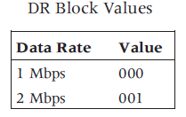
Date Rate
The DR block is three slots long and can take the values listed in Table.
The DR block values are not modulated in PPM.

Slide 11
DC level adjustment
After DR there is a sequence of pulses to allow the receiver to adjust the DC level of the remaining signals.
This is called DC level adjustment (DCLA),
It is needed because the mean value of 4PPM and 16PPM is not the same.
The DC level of these signals would be the same as an aver- age PPM signal at the data rate used.
only these two values are permitted.

Slide 12
LENGTH
The third block is LENGTH, that is the number of bytes of the MPDU.
It is a 16-bit unsigned integer and is the first field to be PPM-modulated.
The LSB is transmitted first.
To assure that the previous value is correctly received a checksum of16 bits is sent.
This is calculated using the polynomial
x¹⁶ + x¹² + x⁵ + 1.
This field is also PPM-modulated.

Slide 13
PSDU
This is the data coming from the MAC.
Its length is defined by the LENGTH field, can vary between 0 and 2,500 bytes, and is PPM-modulated.
The LSB is sent first.
The process of transforming bits to PPM symbols is described in following slides.

Slide 14
The IR physical medium sublayer (IR-PMD)
This layer only describes the signals format and the minimum specifications needed for communication between two IEEE 802.11-IR-conformant devices.
Two data rates are defined: 1 and 2 Mbps.
Both data rates are implemented for the detectors,
but 2Mbps is optional for emitters.
As the emitter power consumption depends heavily on the data rate, the choice is based on battery life for portable devices.
The most common implementation includes a speed and rate that are selected depending on the battery charge.
Also, at the lower speed the receiver sensitivity is larger so that one conversation can be started at one speed,
and if the channel characteristics change, the other one can be used.

Slide 15
Characteristics of the signal used
The electrical and optical signals are based on a 250-ns pulse.
This defines the slot time both for modulated and unmodulated signals.
By using just one fixed-length pulse data, the receiver and emitter can be optimized for this signal, independent of the data rate.
Two PPM schemes are used for sending the data, one for each rate.
Nevertheless, other signals have to be sent unmodulated, at the most obvious data rate.
The data cannot be extracted until the PPM format is established.
A good synchronization is required for PPM data recovering, so a long clock signal is sent at the beginning of each frame.

Slide 16
Pulse position modulation (PPM)
This is the best modulation method for low- and medium-speed optical signals.
In this method, a large pulse is sent.
Its amplitude and shape are not important.
The important factor is its delay relative to a symbol clock.

Slide 17
Pulse position modulation (PPM)
The maximum current that can be applied to an LED has two values:
maximum DC current and
maximum pulsed current.
The first value is due to the thermal dissipation capacity of the device:
the larger the cur- rent, the larger the heat generated and the device temperature.
On the other hand, short and long current pulses can damage the device because of current channeling, and other processes.
In any case, the maximum pulsed current is usually 5 to 10 times larger than DC maximum current.
Of course, the LED should be switched off for a period long enough to lose the heat generated while in the "on" state.
PPM offers a duty cycle low enough to surpass the DC maximum current.
Using, for example, a 16 PPM, the mean current will be about one-sixteenth of the peak cur- rent.
So a 100 mA LED can be driven with 1A pulses, without degrading the device.
On the receiver's photodiode, the signal will be almost 10 times larger.
Unfortunately, the bandwidth needed will be larger too, so the benefits are not so important on the signal-to-noise ratio.

Slide 18
Pulse position modulation (PPM)
There is another factor to be taken into account:
the electrical power needed to turn on the LED.
Usually wireless communications are intended to be used on battery-powered equipment.
If large currents are switched on and off in short pulses, the battery life and the charge duration will be reduced, and
the electromagnetic interference (EMI) propagated through power supply connections could be a problem.
To maintain an almost constant discharge regime, the LED driver charges a large capacitor while in the off state; this capacitor supplies the large cur- rent pulses while in the "on" state.
With this technique, the pulse shape cannot be controlled too tightly, but this is not important in a PPM scheme.

Slide 19
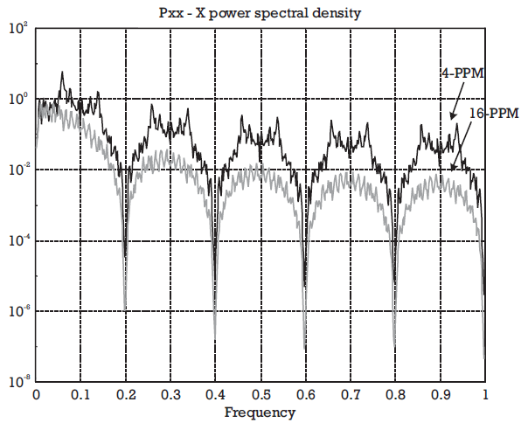
electrical spectrum of a PPM signal.

Slide 20
Pulse position modulation (PPM)
the electrical bandwidth is much larger than the data rate, and this modulation cannot be used if the bandwidth is a scarce resource, as in RF.
Fortunately, the optical spectrum is unregulated because the optical signals are blocked by walls, so a large amount of interference is impossible.
As more and more IR equipment is used, some interference will be unavoidable,
So three options are feasible for the forthcoming developments.

Slide 21
The three options
The first one is to establish the communication based on LOS links;
The second one is to use another wavelength range;
The second option is handicapped by the high cost of optoelectronic devices for longer wavelengths;
The prices will fall as the number of devices increases.
So this problem will diminish if the new applications are successful.
The optical power level can be increased because the sensitivity and transparency of the human eye is lower since larger wavelength are used
They are safer than shorter wavelengths.
and the third is to use a carrier modulation over 2O MHz.
The carrier-modulated option will take advantage of all the circuitry developed for RF, but it will need faster, and again more expensive, emitters and detectors.
In conclusion, IEEE 8O2.11-IR has taken the most convenient position.
The problems will exist for future IR standards.
PPM is the best option.

Slide 22
PPM modulation
Let T₀ be the bit period (i.e., the inverse of the data rate).
The time needed to send k bits will be k .T₀ seconds.
If we divide this time in 2^{k} slices (slots), every one will represent the value of every k-bit combination.
The duration of one slot is T_{s} = k .T₀ / 2 seconds, so no more than a few bits can be grouped before the slot time becomes too short.

Slide 23
PPM modulation
A single pulse placed into a time slot represents the value of the k bits.
Because of this, synchronization is very important: An error in the delay measurement will produce a different bit combination.
IEEE 802.11-IR uses 4-PPM and 16-PPM modulation for 2- and 1-Mbps transmission.
The number indicates the number of slots.
So one symbol (pulse) defines two bits at 2-Mbps, and four bits at 1-Mbps.

Slide 24
PPM modulation
With the synchronization being so critical, the pulse position is not just the plain bit group value.
Instead, a Gray coding scheme is used so that one slot timing error forces one bit error.
With these figures, it is easily seen that Ts is 250 ns in both cases.
What is different is the duty cycle: one-sixteenth at 1-Mbps, and a quarter at 2-Mbps.
If a given amount of data is to be sent, the energy require-ment and the time needed for transmission are different.
Table 3.11 presents these requirements, relative to 1 Mbps.

Slide 25
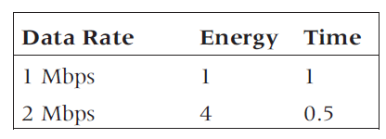
Requirements relative to 1 Mbps

Slide 26
PPM modulation
The basic data unit is the byte (octet), but the symbols are composed of two or four bits,
so bytes have to be broken up before their transmission.
The rule defined is: "Send blocks of bits starting with the less signifi- cant ones, but keeping the internal order inside the block."

Slide 27
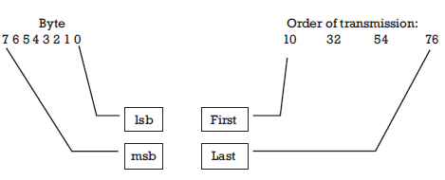
Order for 2-Mbps data rate
Notice that the pair order is kept, so the second symbol transmitted will be the one corresponding to the values of the bit pair 32.
The same rule is applied to l Mbps, but two 4-bit blocks are set up for each byte.

Slide 28
Optical transmitters
Regarding the optical parameters, two kinds of devices are described:
The first is mainly oriented toward active repeaters on the ceiling,
The second is to be implemented in the computers, perhaps as a PCMCIA card.
They differ only in the emission properties, having common receiver characteristics.
The first one has a high power level (2W); this value will exhaust a portable computer battery in a few minutes.
Nevertheless, it is not intended for mobile equipment but rather for being placed on the ceiling to act as an active repeater (AP), so it can be powered from the mains by a power supply.
The beam pattern has a torus-like shape.
A spherical or Lambertian profile would send too much power to the floor lying just under the emitter and much less to the walls.

Slide 29
The optical intensity for direction 2 has to be larger than 1
Because the most probable placement of receivers is on a table at a fixed height and several meters apart from the vertical of the emitter the beam has been designed to cover these positions without wasting power in other directions.
Nevertheless, as the emitted power is high, reflections on walls and furniture can reach the receivers with enough power to be detected.

Slide 30
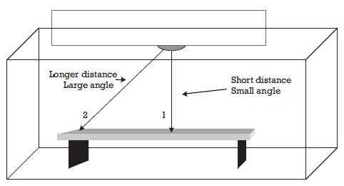
The optical intensity for direction 2 has to be larger than 1

Slide 31
Optical transmitters
The second profile (or mask as it is defined in the standard) emits less peak power (500 mW), and the beam is closer to a cone of 60 degrees.
This beam can be aimed at the repeater or at other devices; in fact, it can be oriented to any white surface that serves as a passive reflector or diffuser.
This one is intended to be used in a portable computer, PDS, or any handheld device.
Although the power is not so low, it should be kept in mind that only when the device is emitting is high power drawn.
In the common use of this equipment, traffic is heavily asymmetric (i.e., port- able devices are to receive most of the information), and only several ACKs are returned.
The option to reduce the data rate to 1 Mbps (with a lower duty cycle) while sending could be a good opportunity for battery- powered devices, while receiving at 2 Mbps.
The wavelength used is in the 850-950-nm range, the one used by IrDA and TV remote controllers, so LED devices are very cheap.
To avoid interference with other (future) devices operating at higher speed, the electrical power spectrum of the pulses should fall by 20 dB at 15 MHz.

Slide 32
Optical receivers
Two power-related parameters are defined for the receiver:
sensitivity and
dynamical range.
The sensitivity is defined as the minimum power density on the receiver surface to achieve a FER of 4 x10⁻⁵ in a 512-byte frame.
This optical power is disturbed by an unmodulated background IR source, so the receiver should be able to recover the signal while other sources, mainly the IR spectrum of illumination lamps, are present.
The sensitivity levels are 2 x10⁻⁵ mW/cm2 at 1 Mbps and 8 x10⁻⁵ mW/cm2 at 2 Mbps.
These values are minima and can be improved to achieve longer distances.

Slide 33
Optical receivers
The optical power on the receiver can take a wide range of values and depends on the relative orientation between emitter and receiver, furni- ture, walls, and the people using the system.
Based on this, a large (30-dB) dynamical range is mandatory for the receiver circuit.
That fact is also responsible for no range distance having been defined in the standard.

Slide 34
Optical receivers
The PHY uses three signals to describe the average availability.
energy detect (ED),
ED is triggered when the optical energy changes more than 1 W/cm² in the 1-10-MHz band.
carrier sense, and
Carrier sense is asserted when a preamble signal has locked the receiver clock.
The receiver clock circuitry may be able to lock it, although the level of the signal is not enough to trigger ED; in this case carrier sense will be asserted, and ED will not.
CCA.
The CCA signal has two states: IDLE if the channel is free and BUSY if the opposite is true.

Slide 35
Optical receivers
When both ED and carrier sense are not asserted, CCA will assume the IDLE state.
Nevertheless, other systems (remote controls, electrically switched fluorescent lamps, etc.) can maintain ED asserted although the channel is free.
In this case, after a period of time with ED asserted but without carry detection, the CCA will change to IDLE.
The state of CCA is sent to MAC, so it can manage all the possible events.

Slide 36
Conclusions and applications
The standard IEEE 802.11 is the first serious and universally accepted standard for WlAN.
It covers the high-quality area of mobile data communications.
As a living standard, several improvements have been developed.
The 802.11a and 802.11b versions take advantage of new RF channels to increase the data rate to 20 or 25 Mbps in the 5.2- and 17.1-GHz bands.
Because the main objectives of WlAN are PDAs and portable computers, a great number of these products are implemented in PCMCIA cards.

Slide 37
Conclusions and applications
As the features of these operating systems promote networking, many services such as file transfer, e-mail, and, of course, Internet connection are available to users.
Other equipment can also take advantage of mobile networking.
For example, moving robots can be controlled from a central computer in a more flexible way.
Other scenarios include meeting rooms, quality control in industries, academic rooms, hospitals, and libraries.
The home scenario is not well suited for 802.11 networks because of the price.
Simpler and cheaper solutions in which all the appliances are controlled by a central unit, are under development for home use.

Slide 38
Conclusions and applications
The possibility of e-mailing and Web browsing offered by new mobile telephones is not, in any sense, an alternative to wireless networking. IEEE 802.11 networks are intended to be implemented as a facility by companies for their workers.
It should never be forgotten that they are based on a LAN standard.
On the other hand, smart mobile phones have improved information processing capabilities.
They do not allow users to modify or resend documents of several pages, including figures, graphs, and tables.
The main makers of WLAN products have set up the WLAN Association (WLANA) to extend and publicize the capabilities of these networks.

