Slide 1
RF WIRELESS SYSTEMS AND STANDARDS
By
SADHISH PRABHU

Slide 2
What is RF?
Radio frequency (RF) is a rate of oscillation in the range of around 3 kHz to 300 GHz, which corresponds to the frequency of radio waves, and the alternating currents which carry radio signals.

Slide 3
What is wireless systems?
A wireless system is any collection of elements (or subsystems) that operate interdependently and use unguided electromagnetic-wave propagation to perform some specified function(s).

Slide 4
What is a standard ?
A level of quality or attainment.
OR
Something used as a measure, norm, or model in comparative evaluations.

Slide 5
What are we going to study?
This course is divided into 5 modules
MODULE I : INTRODUCTION TO CELLULAR STANDARDS
MODULE II: WIRELESS SYSTEMS
MODULE III: THE IEEE 802.11 WLAN STANDARD
MODULE IV: THE IEEE 802.16 WIMAX STANDARD
MODULE V: RECENT ADVANCES
For reference visit www.ecby21.weebly.com

Slide 6
RF frequency band

Slide 7
What is 1G,2G,3G and 4G?
The "G" in wireless networks refers to the "generation" of the underlying wireless network technology
1G networks (NMT, C-Nets, AMPS, TACS) are considered to be the first analog cellular systems, which started early 1980s.
There were radio telephone systems even before that.
1G networks were conceived and designed purely for voice calls with almost no consideration of data services

Slide 8
2G
2G networks (GSM, CDMAOne, D-AMPS) are the first digital cellular systems launched early 1990s.
Offering improved sound quality, better security and higher total capacity.
GSM supports circuit-switched data (CSD), allowing users to place dial-up data calls digitally, so that the network's switching station receives actual ones and zeroes rather than the screech of an analog modem.

Slide 9
2G
2.5G networks (GPRS, CDMA2000 1x) are the enhanced versions of 2G networks with theoretical data rates up to about 144kbit/s.
GPRS offered the first always-on data service.

Slide 10
3G
3G networks (UMTS FDD and TDD, CDMA2000 1x EVDO, CDMA2000 3x, TD-SCDMA, Arib WCDMA, EDGE, IMT-2000 DECT) are newer cellular networks that have data rates of 384kbit/s and more.
The UN's International Telecommunications Union IMT-2000 standard requires stationary speeds of 2Mbps and mobile speeds of 384kbps for a "true" 3G.

Slide 11
4G
4G technology refers to the fourth generation of mobile phone communication standards.
LTE and WiMAX are marketed as parts of this generation, even though they fall short of the actual standard.
The ITI has taken ownership of 4G, bundling into a specification known as IMT-Advanced.
The document calls for 4G technologies to deliver downlink speeds of 1Gbps when stationary and 100Mbps when mobile
Unfortunately, those specs are so aggressive that no commercialized standard currently meets them.

Slide 12
RECENT ADVANCEMENT
Home RF (Access Point (AP))
Blue tooth and Jini Projects ( is a network architecture for the construction of distributed systems in the form of modular co-operating services.)
Security is critical
Wireless system – “anytime , anywhere” service

Slide 13
Contd..
Large number of small cells rather than a few larger cells
Seamless internet service
UWB (Ultra wide band)
Femtocell
Bluetooth
Wi-Fi
Wi-Max

Slide 14
Requirement
Minimum level of interaction is desirable
Impact of software portability
Language constraints
Security issues

Slide 15
Femtocell
Objective:
High date rate and seamless coverage
Issue:
High carrier frequency may have difficulty in penetrating walls so large coverage holes are caused in Macrocell Base station (M-BS)
Statistics :
More than 50% voice calls and 70% data traffic start from indoor environment

Slide 16
Femtocell
Solution:
Deploy some indoor devices serving only the indoor users.
FEMTOCELL EMERGES

Slide 17
What is Femtocell?
A femtocell is a small cellular base station designed for use in residential or small business environments.
It connects to the service provider’s network via broadband (such as DSL or cable) and typically supports 2 to 5 mobile phones in a residential setting.
Allows service providers to extend service coverage indoor.
It also decreases backhaul costs since it routes mobile phone traffic through the IP network.
Called as “home base station”, “access point base station”, “3G access point”, “small cellular base station” and “personal 2G-3G base station”.

Slide 18
Architecture of Femtocell
Has 3 components:
Femtocell base station (F-Bs)
Internet link
Femtocell gateway (FGW)

Slide 19
Femtocell base station (F-Bs)
Short-range, low-cost, low-power indoor devices
It provide service for wireless handsets.
F-BS, which looks like WLAN Access Point (AP), is a small device with at least two wireless and internet interfaces.
Wireless Interface:
This provides wireless radio access to Femtocell MSs.
Any existing wireless telecommunication standard, such as MTS/CDMA200/WIMAX/LTE/EV-DO, can be used at the F-BS wireless interfaces.
Internet Interface:
F-BS Internet interface can be connected to users’ broadband internet DSL or cable modem.
Some F-BS internet interfaces are only allowed to connect to wireless cellular companies own broadband internet, while others can be connected to any ISP internet.

Slide 20
Internet link
Internet Link is a regular ISP broadband Internet connecting multiple F-BSs with an FGW.
Although F-BSs are connected to the Internet similar to an Ethernet connection, different technologies are utilized in the Internet link based on wireless infrastructure.

Slide 21
Femtocell gateway (FGW)
Femtocell Gateway (FGW) is a service provider’s device that acts as a gateway between the Internet and the communication network.
One side of FGW connects a large number of F-BSs via broadband Internet, and the other side of FGW is connected to the telephony core network with the dedicated wired link of the service provider.
In contrast with traditional M-BS, F-BS is connected to FGW via public access Internet, bringing a fundamental change in the network infrastructure.

Slide 22
Femtocell Organization

Slide 23
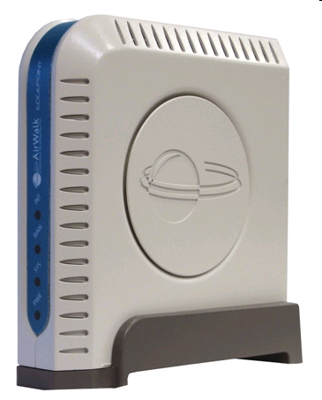
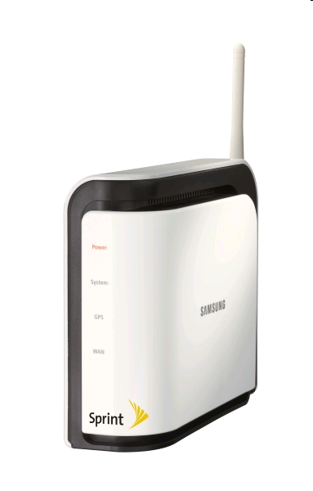
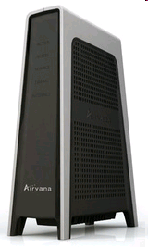
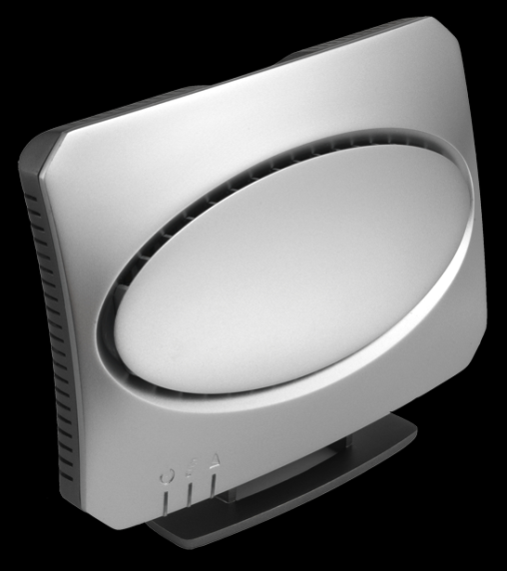
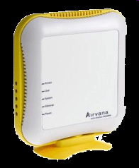
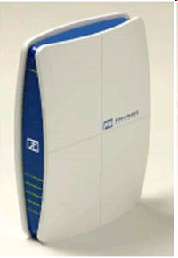
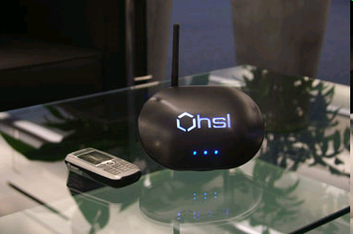
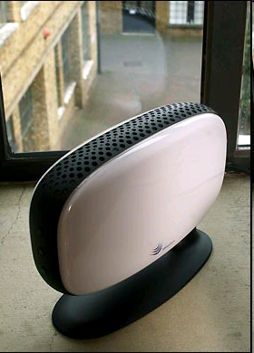
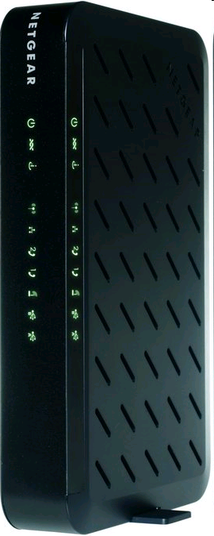
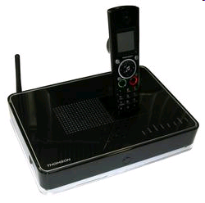
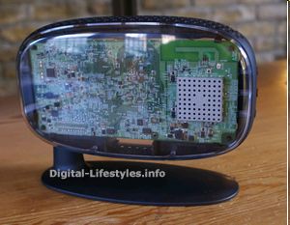
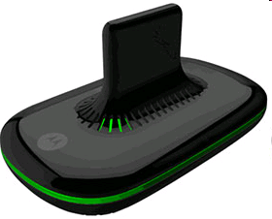
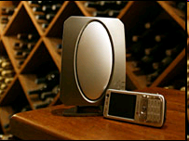
FemtoCell

Slide 24
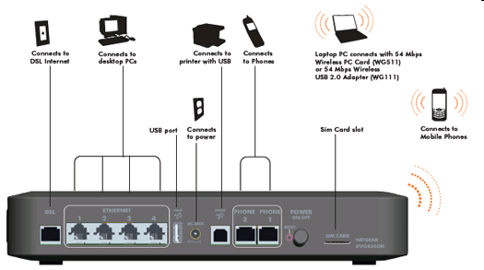
How does it look form behind?

Slide 25
Benefits of Femtocell Network
Improved, seamless coverage
Enhanced capacity
Lower transmit power
Prolonged handset battery life
Higher signal-to-interference-noise ratio (SINR)
The benefits for cellular providers include
Improved Macrocell BSs reliability
Offload data traffic from the Macrocell BSs
Increasing area spectral efficiency
Cost benefits

Slide 26
F-BS versus M-BS

Slide 27
F-BS VS WLAN Access Point

Slide 28
Challenges
Interference
Quality of Service (QoS)
Access Control
Open access mode
Closed access mode
Hybrid access mode
Handoff
Hand-Out
Hand-In
Hand off
Synchronization
Self-Configuration, Self-Operation, and Location Tracking
Security Issues

Slide 29
Ultra-Wideband Technology
Ultra-wideband (UWB) technology, also known as impulse or zero-carrier radio technology
UWB radio system operates across a wide range of the frequency spectrum by Transmitting a series of extremely narrow (10–1000 per second) and low-power pulses
The low-power signaling is accomplished by reusing previously allocated RF bands by hiding the signals under the noise floor of the spectrum

Slide 30
UWB System Characteristics
The UWB signal is defined as a signal with bandwidth greater than 25%of the center frequency or with bandwidth greater than 1 GHz.
UWBsignals are naturally suited for location-determination applications.

Slide 31
Methods of generating UWB signals
Two of the popular methods are
low duty cycle impulse UWB implemented as time modulated—UWB (TM–UWB),
and high duty cycle direct sequence phase coded UWB (DSC–UWB)

Slide 32
TM–UWB technology
The basic element in TM–UWB technology is the monocycle wavelet.
Typically, wavelet pulse widths are between 0.2 and 1.5 nanoseconds, corresponding to center frequencies between 600 MHz and 5 GHz.
The pulse-to-pulse intervals are between 25 and 1000 nanoseconds
The system uses a modulation technique called pulse position modulation
The TM–UWB transmitter emits ultra-short monocycle wavelets with tightly controlled pulse-to-pulse intervals,
These are varied on a pulse-by-pulse basis in accordance with an information signal and a channel code.
The modulation makes the signal less detectable, as the signal spectrum is made smoother by the modulation.
A pulse generator generates the transmitted pulse at the required power.
The transmitter also has a picosecond precision timer that enables precise time modulation, pseudonoise (PN) encoding, and distance determination.

Slide 33
TM–UWB technology
The receiver directly converts the received RF signal into a baseband digital or analog output signal with the help of a front-end cross correlator.
There is no intermediate frequency stage, which reduces the complexity of the transmitter and the receiver design
Generally,
multiple monocycles carry a single bit of information, and at the receiver these pulses are combined to recover the transmitted information.
The precise pulse timing inherently enables accurate positioning and location capability in a TM–UWB system

Slide 34
DSC–UWB technology
Here, the signal is spread by direct sequence modulating a wavelet pulse trains at duty cycles approaching that of a sine wave carrier
The spectrum spreading, channelization, and modulation are provided by a PN (pseudonoise) sequence
The chipping rate is maintained as some fraction of the carrier center frequency

Slide 35
UWB Signal Propagation
UWB impulse wavelets propagate by the free space law.
The coherent interaction of signals arriving by many paths causes the Rayleigh or multipath fading in RF communications.
Inside buildings, when continuous sine waves are transmitted wherein the channels exhibit multipath differential delays in the nanosecond range, the multipath fading occurs naturally .
This issue cannot be resolved by relatively narrowband channels, and hence a significant Rayleigh fading effect must be contended within systems such as IS-95.
Properly designed UWB systems can have bandwidths exceeding 1GHz and are capable of resolving multipath components with differential delays of a fraction of a nanosecond.
Notes:
Interim Standard 95 (IS-95) is the first CDMA-based digital cellular standard

Slide 36
UWB Signal Propagation
For example,
When a monocycle arrives at the receiver using two different paths , the receiver can lock on to either pulse and receive a strong signal.
More than one correlator can be used to lock on to different signals, and energy from the signals can be added, thereby increasing the received S/N.
It is natural and possible that a given pulse may interfere with another late-arriving reflection from the previous pulse in a train of transmitted pulses.
However, these interfering pulses can be ignored, as each individual pulse is subject to PN time modulation and more than one pulse carries the bit energy.
Consequently, this multipath interference may not cause any loss at an UWB receiver; instead, in an in-building environment the UWB system architecture can improve the performance (S/N) by 6 to 10 dB .

Slide 37
Current Status and Applications of UWB Technology
This technology has three distinct application capabilities
Communications,
advanced radar sensing, and
Precision location and tracking.

Slide 38
Current Status and Applications of UWB Technology
The noise like spectral characteristics of UWB signals enable secure communication with a greatly reduced probability of detection.
Short pulse wavelets of TM–UWB that are relatively immune to multipath interference are suitable for robust in-building communications, especially in urban areas .
The precision timing of pulses (in TM–UWB) has enabled the development of through-the-wall radar with detection, ranging, and motion sensing of personnel and objects with centimeter precision .
Another more accurate radar—ground penetrating and vehicle anti-collision radar—is also feasible

Slide 39
Current Status and Applications of UWB Technology
Precision timing also enables applications involving accurate location and tracking capabilities as well as unmanned vehicle applications.
DSC–UWB is suitable for most data communication applications.
high-performance wireless home network,
large bit rate (50 Mbps),
high-speed,
affordable connectivity between devices,
simultaneous data transmission from multiple devices, and
full-motion video capability

Slide 40
Current Status and Applications of UWB Technology
Since the UWB signal can provide undetectable interference with other signals, UWB can coexist with other technology (Bluetooth, 802.11a/b/g) without mutual disruption.
UWB technology can also be useful for a lot of WPAN applications,
such as enabling high-speed wireless universal serial bus (WUSB) and
Wireless PC peripheral connectivity, and replacing cables in next-generation
Bluetooth technology devices,
high-speed and low-power MANET devices.
Notes:
Wireless Personal Area Network WPAN

Slide 41
Difference Between UWB and Spread Spectrum Techniques
UWB uses an extremely wide band of RF spectrum to transmit more data in a given period of time.
The spread spectrum techniques include direct sequence spread spectrum and frequency-hopping spread spectrum.
the spread spectrum signal is modulated by a carrier with a PN pseudorandom code or hopping pattern to move the already spread signal to the most suitable band for transmission.
UWB is a time-domain concept and there is no carrier modulation
Low-duty cycle (0.5%) leads to a large peak-to-average ratio and low power consumption.

Slide 42
UWB Technology Advantages
less interference
low probability of detection and
excellent multipath immunity.
precise range information,
strong capability for overcoming very high levels of interference from other narrowband devices .
less complex,
lower cost and
smaller
Broad consumer adoption of wireless networking technology can finally become a reality.

Slide 43
UWB Technology Drawbacks
UWB is a disruptive technology for wireless networking applications [16.4], and its use would not be appropriate for a WAN deployment such as wireless broadband access.
UWB devices are power limited because they must coexist on a noninterfering basis with other licensed and unlicensed users across several frequency bands.
Furthermore, antenna gain cannot be increased to operate at greater range since power limits on UWB devices are angle independent.
An implementation in low voltage CMOS (complementary metal oxide semiconductor) is not possible as some UWB systems might exhibit a high peak-to-average ratio (PAR) .
For UWB systems using PPM as their modulation technique, limited jitter requirements could be an issue.

Slide 44
Challenges for UWB Technology
UWBsystem designers need to provide an extremely accurate pulse design that produces emissions with flat and wide power spectral densities.
Harmful interference effects of UWB signals to narrowband receivers and those of narrowband transmitters to UWB receivers must be understood completely.
Requirements for the PHY and MAC functions of wireless devices based on UWB-radio technology (UWB-RT) must be understood.
Since UWB radio devices are suitable for communications and location tracking applications and services, there is a need to determine under what conditions and in what way the functions of communication and location tracking can or should be combined.
Notes:
PHY- Physical Layer

Slide 45
Challenges for UWB Technology
It is necessary to ensure that implementation of UWB technology does not cause interference to systems operated in the radio spectrum used for aeronautical safety, public safety, emergency and medical, military, and other consumer and business product services.
New measurement techniques are needed to measure the characteristics of noise like UWB signals having transient behavior.
It is necessary to identify and standardize the requirements and characteristics for a wireless home network with a variety of devices connected to each other.

Slide 46
Future Directions
UWB technology has several unique characteristics, including
high capacity,
low probability of multipath fading,
interference immunity,
low probability of detection, and
frequency diversity,
which allow for a simpler and more cost-efficient radio design.
UWB is suitable for a broad variety of applications and, when implemented efficiently, has the potential to address the “spectrum drought.”

