Slide 1
SERVICES PROVIDED BY IS2000
By
V.kokila

Slide 2
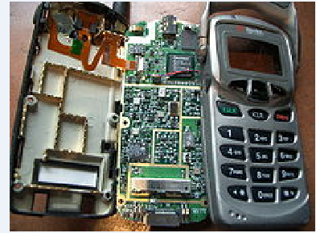
FIRST CDMA SAMSUNG PHONE

Slide 3
IS-95
First CDMA mobile phone system found widely in north America
Carry data rates up to 14.4kbps for IS-95A
115kbps for IS-95B

Slide 4
IS-2000
CDMA2000 1X (IS-2000) also known as 1x and 1xRTT, is the core CDMA2000 wireless air interface standard
Supports circuited switched voice
35 simultaneous call per sector
Doubles the capacity of original IS-95 standard
supports packet data speeds of up to 153 Kbit/s in both direction

Slide 5
3G CDMA SYSTEMS
In 3G and beyond 3G CDMA systems ,higher SIR of the received signal is required so that high order modulation schemes can be applied to achieve high data transmission throughput.
Spectral efficient modulation schemes (8-PSK, 16-QAM)
low spreading factors are used to increase the data transmission throughput.
IS-95 and IS-2000 CDMA systems, that applies BPSK and QPSK modulations for voice communications

Slide 6
WIRELESS INTERNET ACCESS USING IS-2000 THIRD GENERATION SYSTEM
Enhancements to IS-2000 (1x-EV) and UMTS (HSDPA) standards are already underway to support peak data rates of 2 to 20 Mb/s.

Slide 7
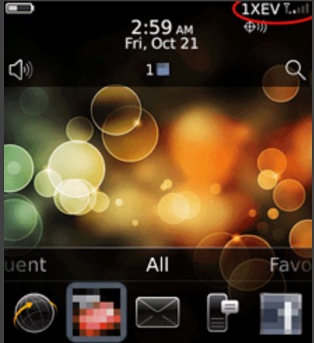
1XEV MOBILE PHONE BLACKBERRY

Slide 8
CDMA2000 1X EV-DV
Evolution data and voice
Channel bandwidth of 1.25MHZ was insufficient for higher data rates
CDMA 2000 system involves utilizing channel bandwidth of 3 times the standard 1.25MHZ-3XRTT

Slide 9
CDMA2000 1X EV-DO
Enhanced voice data optimized or Enhanced voice data only(EV-DO) for the wireless transmission of data through radio signals
EV-DO is an evolution of the CDMA2000(IS-2000)
It is also used on the Globalstar Satellite phone network

Slide 10
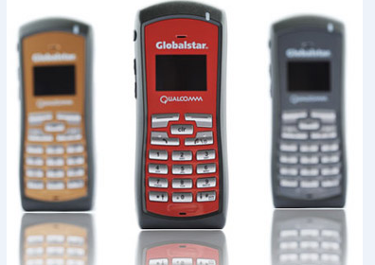
GLOBALSTAR PHONE SYSTEM

Slide 11
GSP-SATELLITE PHONE
Optimal voice clarity
Longer battery lifetime-4hours talktime,36 hours standby
Faster data speeds at 9.6kbps
Position location service-latitude and longitude position directly from phone

Slide 12
THANK YOU

