Slide 1
The IEEE 802.11 standard
By
Sadhish Prabhu

Slide 2
Contents
General Description
MAC for the WLANs
Physical Layer for WLANS: Radio systems
Physical Layer for WLANS: IR systems
Applications

Slide 3
General Description
Notes:
MMDS- Multichannel Multipoint Distribution Service
LMDS - Local Multipoint Distribution Service

Slide 4
What 802.11?
802.11 is an IEEE standard for MAC and Physical Layer for Wireless Local Area Network (WLAN).

Slide 5
Standardization of Wireless Networks
Wireless networks are standardized by IEEE.
Under 802 LAN MAN standards committee.
Application
Presentation
ISO
OSI
7-layer
model
Session
IEEE 802
standards
Transport
Network
Logical Link Control
Data Link
Medium Access (MAC)
Physical
Physical (PHY)

Slide 6
Why Standard?
Multi Vender inter operability
Protects customer investment
Economies of scale

Slide 7
Why not Wireless Ethernet?
Ethernet (802.3) is simple, widely used, cheap ...
But
Collision Detection
Not possible in wireless
Would require a full duplex radio
Receiver sensitivity
Mobility
Power Save

Slide 8
802.11 Versions
802.11 - 1997
Maximum data rate: 2Mbps
2.4Ghz band
Indoor Range: 20 meters
Outdoor Range: 100 meters
Wide range of Physical layers
802.11a - 1999
Maximum data rate: 54Mbps
5.1 - 5.8Ghz band
Indoor range: 35 meters
Outdoor range: 120 meters
54 Mbps

Slide 9
802.11 Versions
802.11b - 1999
Maximum data rate: 11Mbps
2.4Ghz band
Indoor Range: 38 meters
Outdoor Range: 140 meters
11 Mbps
802.11g - 2003
The current industry adopted specification
Maximum data rate: 54Mbps
2.4Ghz band (backwards compatible with 802.11b)
Indoor range: 38 meters
Outdoor range: 140 meters
54 Mbps

Slide 10
IEEE 802.11 Overview
Goals
To deliver services in wired networks
To achieve high throughput
To achieve highly reliable data delivery
To achieve continuous network connection.

Slide 11
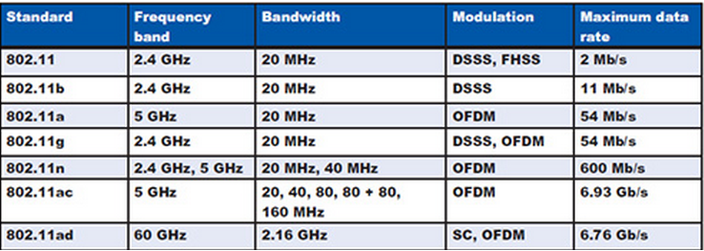
Generation of IEEE 802.11
Notes:
SC

Slide 12
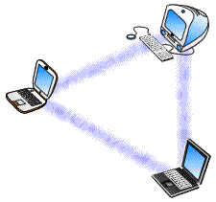
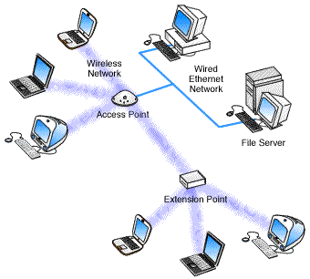
Operating Modes
Adhoc Network
Infrastructure Network

Slide 13
What is WiFi?
A trademark of the Wi-Fi Alliance
Founded in 1999 as WECA (Wireless Ethernet Compatibility Alliance).
More than 300 companies
WiFi certification warrants interoperability between different wireless devices
Ensures correct implementation IEEE 802.11
Tests the wireless components to their own terms of reference

Slide 14
Medium Access Control
Wireless channel is a shared medium
MAC coordinates transmission between users sharing the spectrum
Goals: prevent collisions while maximizing throughput and minimizing delay

Slide 15
MAC for IEEE 802.11
Features of a WLAN MAC protocol
Standardized access methods
Distributed coordination function (DCF), with or without handshaking
The point coordination function (PCF)
Comparision between IEEE 802.11 MAC and HIPERLAN MAC

Slide 16
Important characteristics of MAC
Functionality and duty of every station is controlled
MAC protocol support
The access point (AP) – oriented and ad hoc networking topologies
Both asynchronous and time critical traffic (called time – bounded services in 802.11)
Power management

Slide 17
Basic Service Set (BSS)

Slide 18
Extended Service Set (ESS)
Distribution System
Portal
Notes:
A wireless ad hoc network is a decentralized type of wireless network. The network is ad hoc because it does not rely on a pre existing infrastructure, such as routers in wired networks or access points in managed (infrastructure) wireless networks.

Slide 19
Features of MAC
Throughput
Delay
Transparency to different PHY layers
Fairness of access
Battery power consumption
Maximum number of node and maximum coverage area
Robustness vs co channel access and interference
Establishing peer to peer connectivity without a priori knowledge
Ability to support hand off/ roaming between service areas
Ability to support broadcast (multicast)
Insensitive to capture effects
Support of priority and non reciprocal traffic
Human safety

Slide 20
Throughput
WLANs operate at data rates of 1-20 Mbps.
The ALOHA family suffers from stability problems.
That is, the peak throughput is accompanied by a tremendous delay.
With Ethernet, and its 10 Mbps of physical transmission it delivers over 8 Mbps of theoretical performance, but, in practice, only 3-3.5Mbps performance is achieved.
We should consider not only theoretical throughput but operating throughput.
One way of increasing the throughput is by using spread spectrum techniques, which support multiple transmissions simultaneously.
The impact of unauthorized network access.
Neither the MAC nor network management functions can identify any unauthorized access before receiving its transmission.

Slide 21
Delay
They should serve not only the mandatory asynchronous data service, but also time-bounded multimedia applications.
Delay can also cause problems for all data services where the preservation of the sequence of packets is extremely important.

Slide 22
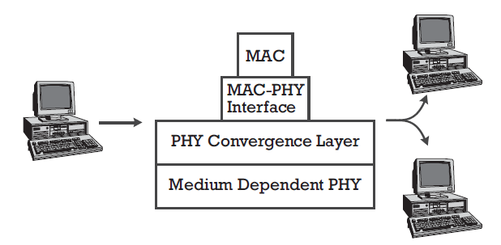
Transparency to different PHY layers
Physical transmission layers include
direct sequence spread spectrum (DS-SS),
frequency- hopped spread spectrum (FH-SS), and
diffuse IR.
These physical transmission layers are different in propagation characteristics.
However, one MAC must handle all of them.
One way of achieving this goal is to have
a physical dependent layer,
a physical convergence layer, and
an appropriate MAC-PHY interface in each station.
A single MAC can exchange data transparently with different PHYs via the MAC-PHY interface.
Directly related to this item is the limitation of the complexity of the PHY to a minimum.

Slide 23
Fairness of access
The fading characteristics of indoor channels may cause unequal received power at the base station even when power control is enforced.
Such a situation may result in unfair access to the network.
That is, one mobile node may receive much less power at the base station than another mobile node.
When the MAC protocol is operating in the contention mode (necessary for initial registration and often used for uplink traffic), the disadvantaged mobile node may not have a chance to access the channel for a while.
A MAC protocol should be able to resolve this situation since it is possible that capture can take place with as small as a 6-9 dB power difference while the dynamic range of fading can be as large as several dBs.
Notes:
In telecommunications, the capture effect, or FM capture effect, is a phenomenon associated with FM reception in which only the stronger of two signals at, or near, the samefrequency will be demodulated.

Slide 24
Battery power consumption
Typically, the 110V (or 220V) electrical supply provided in a building powers device connected to a wired network.
Wireless devices, however, are meant to be portable and/or mobile and are typically battery-powered.
Devices must be designed to be very energy-efficient, resulting in "sleep" modes and low-power displays, enabling users to make cost versus performance and cost versus capability tradeoffs.
Many proposed higher-level protocols require mobile nodes to constantly monitor access points or handshake with base stations for the purpose of synchronization, pointer control, or exchanging state information.
Therefore, very limited power should be used for packet transmission.
Sleep mode should be possible at the receiver front end.
The active receive mode may consume more battery power than transmission mode operation since modern commercial digital communication systems may typically have transmission power of 100 mW but need 100 mA of current to sup- port the digital signal processor operation at the receiver

Slide 25
The maximum number of nodes and maximum coverage area
The typical coverage area for WLANs ranges from 10m² to 100m², which introduces less than a 1,000 ns propagation delay.
WLANs operate 10-20M chips per second (c/s) for DS-SS and more than 1M symbols per second for other PHYs.
Delay in the 500 -1,000 ns range can cause big prob- lems for some MACs: a synchronous CDMA system
It is the ability to work in a wide range of systems, with a MAC design that can handle the geo- graphical size and number of nodes in the LAN.

Slide 26
Robustness vs cochannel access and interference
A big challenge to designing a WLAN MAC is to work successfully in the case of collocated networks, which can cause severe co channel interference.
Two or more WLANs to operate in the same region or in some regions where interference between different LANs may occur.
Some protocols cannot function normally in this situation.
For instance, consider two WLANs operating in two nearby buildings.
For certain parts of these LANs, it may be more difficult to communicate with other parts of their own LAN than to communicate with the other LAN.
Serious trouble can result from this situation if the MAC uses token passing.
It is possible to mistakenly pass the token to a node in the other network.
Generally speaking, there are two concerns for collocated networks, described as follows:
Security:
Other users may illegally break into the network, causing a security alert.
This can be solved by an appropriate authentication procedure for new users.
Interference from collocated networks:
For example, if we apply traditional CSMA protocols in WLANs, interference from another network can cause disastrous hidden terminal problems.

Slide 27
Robustness vs cochannel access and interference
Interference in wireless communications can be caused by simultaneous transmissions (i.e., collisions) by two or more sources sharing the same frequency band.
Collisions are typically the result of multiple stations waiting for the channel to become idle and then beginning transmission at the same time.
Collisions are also caused by the "hidden terminal," problem, where a station, believing the channel to be idle, begins transmission without successfully detecting the presence of a transmission already in progress.
Interference is also caused by multipath fading, which is characterized by random amplitude and phase fluctuations at the receiver.
The reliability of the communications channel is typically measured by the average BER.
For packetized voice, packet loss rates on the order of 10⁻² are generally acceptable; for uncoded data, a BER of 10⁻⁵ is regarded as acceptable.
Automatic repeat request (ARQ) and forward error correction (FEC) are used to increase reliability.

Slide 28
Robustness vs cochannel access and interference
In infrastructure LANs, multicell coverage is governed by an AP, which is typically a base station or a repeater.
The coverage of each cell should overlap the neighboring cell(s) properly;
that is, the overlapping region is intended to be minimized to increase system capacity but also kept to a certain proportion so that seamless service is possible.
This joint region between cells introduces extra problems.

Slide 29
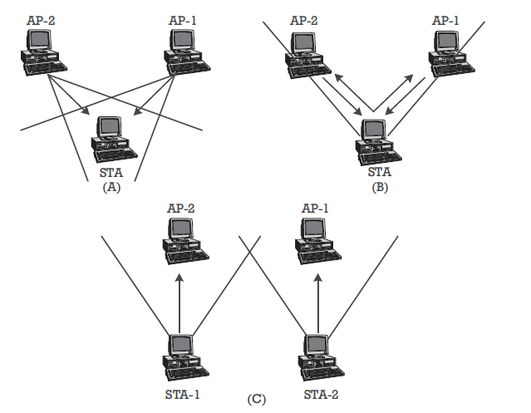
Typical cases of interference:
(a) self-interference,
(b) self-collision, and
(c) and up-down collision.

Slide 30
Summarization of the problems
Self-interference:
When two APs (such as two repeaters) try to transmit a packet to a node in the joint region simultaneously.
This causes interference and the packet is likely to be lost.
Self-collision:
A node in the joint region transmits a packet that is received by more than one AP.
This causes collision or band- width waste while routing this packet to its destination(s).
Up-down collision:
A node (A) in one cell is transmitting uplink while another node (B) in another cell is receiving downlink.
It is possible that node B may be able to hear (receive) node A's transmission, and this situation results in collision,
This situation which is similar to the hidden terminal problem and is a problem as yet unsolved in multicell infrastructure LANs-is very unlikely if the cells are well separated.
Since up-down collisions are very destructive, any MAC should take it into account carefully.

Slide 31
Summarization of the problems
The first two problems can be eliminated by careful coordination between Aps
However, the up-down collision can only be alleviated; it can never be solved practically.
The other issue is security.
Data privacy is usually accomplished in a radio medium using encryption.
While encryption of wireless traffic can be achieved, it is usually at the expense of increased cost and decreased performance of the MAC.
IEEE 802.11 supports the 802.11 draft standard, which specifies an (optional) data encryption algorithm called the wired equivalency privacy (WEP) algorithm.
The WEP algorithm is based on the RC4PRNG algorithm developed by RSA Data Security, Inc.

Slide 32
Establishing peer-to-peer connectivity without a priori knowledge
The MAC of a WLAN should support ad hoc networking.
Therefore, there should be no requirement for a priori information about network topology (e.g., whether there is communication between all nodes).

Slide 33
The ability to support hand-off/roaming between service areas
MAC protocol had to support a hand-off function to serve nodes moving from one cell to another.
However, this is not a real limiting consideration because portable computers are not real mobile computers, and users normally work in a fixed place.
Nevertheless, a MAC should consider this issue, which is a special feature of WLANs.
In indoor environments, due to fast fading, hand-off is not a straightforward problem.
The ability of a MAC to support hand-off in real time is not an easy task if we take power consumption into consideration.

Slide 34
The ability to support broadcast (multicast)
Broadcasting is the natural form of communication for downlink traffic in wireless networks, the MAC should support multicast.
Notes:
Multicast: send (data) across a computer network to several users at the same time.

Slide 35
Insensitivity to capture effects
The capture effect can increase throughput, it can also prohibit fair access.
One solution is to enforce insensitivity at the receiver end.
A MAC is expected to maintain receiver sensitivity to enhance physical transmission and avoid any potential problems from capture.

Slide 36
Support of priority and non-reciprocal traffic
The MAC is expected to support traffic with different priorities.
A special feature of WLAN traffic is that the downlink traffic is often much greater than the uplink traffic.
A good MAC should definitely support this feature.

Slide 37
Human safety
Whether RF transmissions from radio and cellular phones are linked to human illness.
Networks should be designed to minimize the power transmitted by network devices.
For IR WLAN systems, optical transmitters must be designed to prevent vision impairment.
MAC protocols must be able to work with emission levels low enough to avoid safety complications.

