Slide 1
The structure of the IEEE standard MAC protocol

Slide 2
Introduction
It consists of one or more basic service sets (BSS) that are interconnected with a distribution system (DS).
BSS is the fundamental building block of the IEEE 802.11 architecture.
A BSS is defined as a group of stations (STAs) that are under the direct control of a single coordination function.
This coordination function can be DCF (Distributed Coordination Function) or PCF (Point Coordination Function).
The geographical area covered by the BSS is known as the basic service area (BSA).
Conceptually, all stations in a BSS can communicate directly with all other stations in a BSS.
Due to multipath fading, or interference some stations appear to be hidden from other stations.
An ad hoc network is the deliberate grouping of stations into a single BSS for the purpose of internetworked communications without the aid of an infrastructure network.
Independent BSS (IBSS) is the formal name of an ad hoc network in the IEEE 802.11.

Slide 3
Infrastructure networks
They are established to provide wireless users with specific services and range extensions.
Infrastructure networks are established using APs.
The AP is analogous to the base station in a cellular communication network.
The AP supports range extensions by providing the integration points necessary for network connectivity between multiple BSSs, thus forming an extended service set (ESS).
The ESS consists of multiple BSSs that are integrated together using a common DS.
The DS can be thought of as a backbone network that is responsible for MAC-level transport of MAC service data units (MSDUs).
The DS, as specified by IEEE 802.11, is implementation-independent.
Therefore, the DS could be
a wired IEEE 802.3 Ethernet LAN,
an IEEE 802.3 token bus LAN,
an IEEE 802.5 token ring LAN,
a FDDI-MAN, or
another IEEE 802.11 wireless medium.

Slide 4
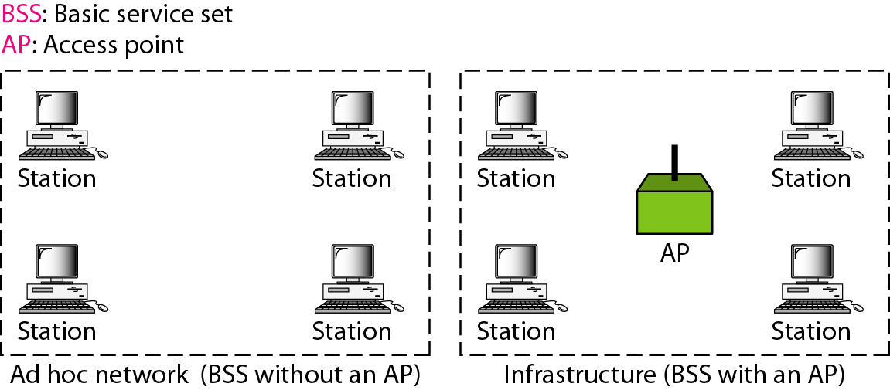
Basic service sets (BSSs)

Slide 5
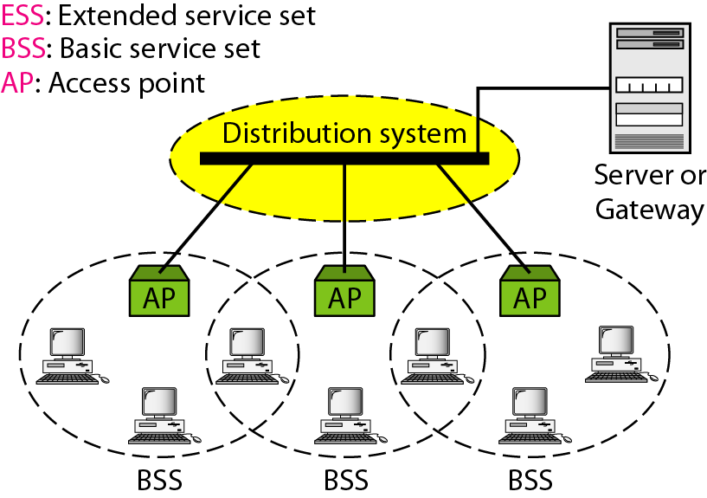
Extended service sets (ESSs)

Slide 6
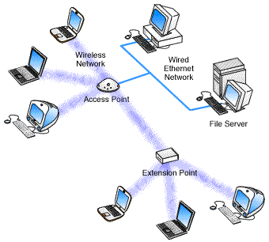
Extended Service Set (ESS)
Distribution System
Portal
Notes:
A wireless ad hoc network is a decentralized type of wireless network. The network is ad hoc because it does not rely on a pre existing infrastructure, such as routers in wired networks or access points in managed (infrastructure) wireless networks.

Slide 7
Portal
An ESS can also provide gateway access for wireless users to a wired network such as the Internet.
This is carried out via a device known as a portal.
The portal is a logical entity that specifies the integration point in the DS where an IEEE 802.11 network integrates with a non-IEEE802.11 network.
It provides range extensions and the transfer between different frame formats.

Slide 8
Note
A BSS without an AP is called an ad hoc network;
A BSS with an AP is called an infrastructure network.
DS could physically be the same transmission medium as the BSS, but they are logically different, because the DS is solely used as a transport backbone to transfer packets between different BSSs in the ESS.

Slide 9
Summary of Ad-Hoc architecture
Lack of an AP;
No functionality to support mobility;
Only support data transfer between stations belonging to the same WLAN.

Slide 10
Coordination functions
Supports one mandatory and two optional coordination function schemes
Distributed coordination function (DCF), based on a CSMA with collision avoidance (CSMA/CA) protocol.
DCF with handshaking-the request to send (RTS)-clear to send (CTS) procedure-is an optional CF.
Point coordination function (PCF) for distributed time-bounded services (DTBS) in which a point coordinator (or PCF station) has priority control of the medium.

Slide 11
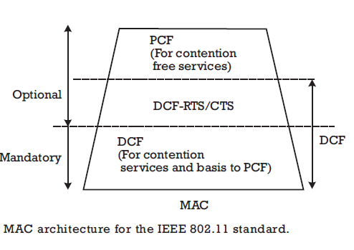
MAC architecture

Slide 12
Distributed coordination function (DCF)
It is the fundamental access method used to support asynchronous data transfer.
All stations must support the DCF.
The DCF operates solely in the ad hoc network and either operates solely or coexists with the PCF in an infrastructure network.
It supports contention services.
Contention services imply that each station with an MSDU queued for transmission must compete for access to the channel and, once the MSDU is transmitted, must recontend for access to the channel for all subsequent frames.
Contention services promote fair access to the channel for all stations.

Slide 13
Why CSMA protocol in MAC?
The DCF is based on CSMA/CA, which is attractive to both vendors and researchers due to the popularity of Ethernet.
CSMA is a member of the ALOHA family of protocols.
ALOHA was the first multiple/random access protocol to be applied to large-scale wireless networks.
Pure ALOHA can present unstable behavior when many collisions must be handled.
This can result in an unacceptable degradation of the throughput.
Improved versions (slotted ALOHA) reduce the possibility of collision duration.
CSMA, which senses the status of a channel before transmitting, is the simplest way to improve ALOHA.
CSMA demonstrates an increase in throughput.
Therefore, the IEEE 802.3 committee chose persistent CSMA/CD as the MAC for wired LANs.
The success of CSMA/CD in Ethernet relies on the ease of sensing the carrier by measuring the current or voltage in the cable.

Slide 14
Challenges
Carrier sensing is a major problem for radio networks due to the hidden terminal problem .
Reliable carrier sensing is extremely difficult to severe channel fading in indoor environments.
Carrier sensing is performed at both the
air interface, referred to as physical carrier sensing,
MAC sublayer, referred to as virtual carrier sensing.
Physical carrier sensing detects the presence of other IEEE 802.11 WLAN users by analyzing all detected packets and detects activity in the channel via relative signal strength from other sources.
CSMA/CD is not used, because a station is unable to listen to the channel for collisions while transmitting.

Slide 15
Challenges
In radio systems that depend on the physical sensing of the carrier, a problem called the hidden node problem arises.
In this situation, a single receiving station can hear two different transmitters, but the two transmitters cannot hear the carrier signals of one another.
In this type of topology, the transmitters send frames without performing a random backoff.
This results in the likelihood of collision.
To alleviate the hidden terminal problem and to increase reliability, CSMA/CA is used.

Slide 16
CDF with handshaking (RTS-CTS procedure) (optional )
The 802.11 MAC protocol includes a well-known mechanism for solving the hidden node problem.
The protocol makes use of two control frames:
A RTS frame that a potential transmitter sends to a receiver
A CTS frame that a receiver sends in response to a transmitter‘s RTS frame.

Slide 17
NAV
The CTS frame gives the requesting station permission to transmit while notifying all stations within radio range not to initiate any transmissions for a given time. This is called the net allocation vector (NAV) .
NAV indicates the amount of the time that must elapse before the current transmission session is complete.
The channel is marked busy if either the physical or virtual carrier sensing mechanisms indicates that the channel is busy.

Slide 18
CDF with handshaking
Because of the signaling overhead involved, the RTS/CTS feature is not used for short packets, for which the likelihood of collision and cost (in terms of retransmission time) are both small anyway.
If RTS/CTS is not used, the duration field of the data frames make a reality of NAV.

Slide 19
DCF transmission procedure
A source station performs virtual carrier sensing (NAV actualization) by sending MPDU duration information in the header of RTS, CTS, and/or data frames.
An MPDU is a complete data unit that is passed from the MAC sublayer to the physical layer.
The MPDU contains information, payload, and a 32-bit CRC.
The duration field indicates the amount of time in which the channel will be used to complete successful transmission of the data or management frame.

Slide 20
DCF transmission procedure - IFS
Priority access is controlled through the use of the interframe space (IFS), a time interval between the transmission of frames.
Three IFS intervals are specified in the standard:
short IFS (SIFS),
point coordination function IFS (PIFS), and
DCF IFS (DIFS).
Note:
The SIFS interval is the smallest IFS, followed by PIFS and DIFS, respectively.

Slide 21
Example Procedure
When a station senses that the channel is idle, the station transmits an MPDU.
The receiving station calculates the checksum and determines whether the packet was received correctly.
Upon receipt of a correct packet, the receiving station waits for a SIFS interval and transmits a positive ACK frame to the source station, indicating that the transmission was successful.
When the data frame is transmitted, the duration field of the frame is used to let all stations in the BSS know how long the medium will be busy.
All stations hearing the data frame adjust their NAV based on the duration field value, which includes the SIFS interval and the ACK following the data frame.

Slide 22
Use of RTS and CTS
Since a source station in a BSS cannot hear its own transmissions, when a collision occurs a lot of channel bandwidth is wasted due to a corrupt MPDU
a station can use RTS and CTS control frames to minimize the bandwidth wastage

Slide 23
Procedure using RTS and CTS
The source station first transmits the RTS control frames with a data or management frame queued for transmission to a specified destination station.
All stations in the BSS hear the RTS packet with a CTS packet after a SIFS idle period has elapsed.
Stations hearing the CTS packet look at the duration field and again update their NAV.
After receiving CTS, the source station is virtually assured that the medium is stable and reserved for successful transmission of the MPDU.
Notes:
Note: stations are capable of updating their NAVs based on the RTS from the source station and CTS from the destination station, which helps to combat the hidden terminal problem.

Slide 24
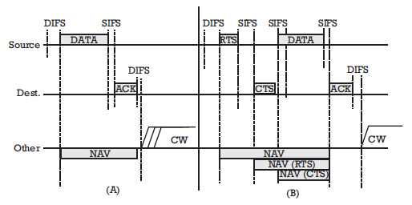
Timing diagram of a successful data frame transmission
Without handshaking
Using the RTS/CTS mechanism

Slide 25
Contd..
Stations can choose from among the following options:
Never use RTS/CTS;
Use RTS/CTS whenever the MSDU exceeds the value of RTS_ Threshold
Always use RTS/CTS.

Slide 26
Fragmentation
Large MSDUs handed down from the LLC to the MAC may require fragmentation to increase transmission reliability.
To determine whether to perform fragmentation, MPDUs are compared to the manageable parameter Fragmentation_Threshold.
If the MPDU size exceeds the value of Fragmentation_Threshold, the MSDU is broken up into multiple fragments.
The resulting MPDUs are of size Fragmentation_Threshold.
Notes:
Typically the range used for fragmentation threshold is 256-2346. The default value for many devices is set to be 2346. Typically this means that it is disabled and will never be used.

Slide 27
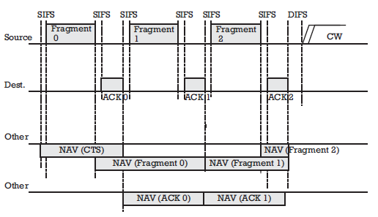
Timing diagram of a successful fragmented data frame transmission

Slide 28
DCF collision avoidance (basic access) procedure
The collision avoidance portion of CSMA/CA is carried out through a random backoff procedure
If the medium is busy, the station defers until after a DIFS is detected and then generates a random backoff period for an additional defer interval before transmitting
contention window (CW), this minimizes collisions during contention between multiple stations.

Slide 29
Backoff period
The backoff period is the unit of measurement used by the backoff timer.
The backoff timer is decreased only when the medium is idle; it is frozen when the medium is busy.
After a busy period the decreasing of the backoff timer resumes only after the medium has been free longer than the DIFS.
A station initiates a transmission when the backoff timer reaches zero.

Slide 30
Backoff interval
The backoff interval is chosen following Int[2^{2+i}·ranf()]·Slot_Time
where “i” is the number of consecutive times a station attempts to send an MPDU,
ranf() is a uniform random variable in (0,1),
Int[x] represents the largest integer less than or equal to x.
ranf() is a pseudo-random number between 0 and 1
while Slot_Time is a time period.

Slide 31
Slot time
For IEEE 802.11, time is slotted in time periods that correspond to a Slot_Time.
the slot time is equal to the transmission time of one packet,
the Slot_Time used in IEEE 802.11 is much smaller than an MPDU
used to define the IFS intervals and determine the backoff time for stations in the contention period (CP).

Slide 32
Slot time
The Slot_Time is different for each physical-layer implementation.
It corresponds to
the sum of clear channel assessment time (time required to determine that the channel is idle),
Rx_Tx turnaround time (time required for the modem to change from a receiving to transmitting configuration and vice versa), and
air propagation time.

Slide 33
The advantage of this channel access
It promotes fairness between stations,
All stations have equal probability of gaining access to the channel after each DIFS interval.
Time-bounded services typically support applications such as packetized voice or video.
With DCF, there is no mechanism to guarantee minimum delay to stations supporting time-bounded services

Slide 34
Point coordination function (PCF)
The PCF is an optional capability and provides contention-free frame transfer.
It relies on the point coordinator (PC) [AP] to perform polling, enabling polled stations to transmit without contending for the channel.
Stations within the BSS that are capable of operating in the contention-free period (CFP) are known as CF-aware stations.
The method by which the polling tables are maintained and the polling sequence is determined is left to the imple menters.
The main applications of this capability are time-bounded services in which packet order is a main concern.

Slide 35
PCF contd..
The PCF is required to coexist with the DCF
The CFP_Rate determines the frequency with which the PCF occurs.
A portion of the time is allotted to contention-free traffic, and the remainder is provided for contention-based traffic.
A beacon frame initiates the CFP repetition interval, where the AP transmits the beacon frame.
One of its primary functions is synchronization and timing.
The duration of the CFP repetition interval is always an integer number of beacon frames.
Once the CFP_Rate is established, the duration of the CFP is determined.

Slide 36
PCF contd..
The maximum size of the CFP is determined by the manageable parameter CFP_Max_Duration.
It varies between a minimum (time required to transmit two maximum-sized MPDUs, including overhead, the initial beacon frame, and a CF-End frame) and a maximum (CFP repetition interval minus the time required to successfully transmit a maximum- sized MPDU during the CP, including time for RTS/CTS handshaking and ACK).

Slide 37
PCF contd..
Time must be allotted for at least one MPDU to be transmitted during the CP.
It is up to the AP to determine how long to operate the CFP.
If traffic is very light, the AP may shorten the CFP and provide the remainder of the repetition interval for the DCF.
The CFP may also be shortened if DCF traffic from the previous repetition interval carries over into the current interval.

Slide 38
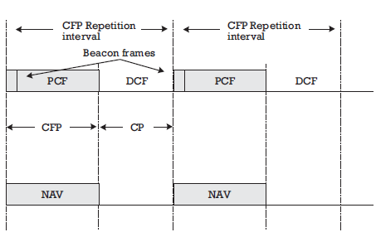
CFP repetition interval

Slide 39
PCF contd..
The maximum amount of delay for a frame or fragment on the CFP interval is the time needed to transmit an RTS/CTS handshake, a maximum length MPDU, and ACK.
At the nominal beginning of each CFP repetition interval, all stations in the BSS update their NAV to the maximum length of the CFP (i.e., CFP_Max_Duration).
During the CFP, the only time stations are permitted to transmit is in response to a poll from the point coordinator or for transmission of an ACK (a SIFS interval after receipt of an MPDU).

Slide 40
PCF transmission procedure
At the nominal start of the CFP, the point coordinator senses the medium.
If the medium remains idle for a PIFS interval, the point coordinator transmits a beacon frame to initiate the CFP.
The point coordinator starts contention-free (CF) transmission a SIFS interval after the beacon frame is transmitted by sending a CF-Poll (no data), Data, or Data+CF-Poll frame.

Slide 41
PCF transmission procedure contd..
The point coordinator can immediately terminate the CFP by transmitting a CF-End frame.
If a CF-aware station receives a CF-Poll (no data) frame from the point coordinator, the STA can respond to the point coordinator after a SIFS idle period, with a CF-ACK (no data) or a Data+CF-ACK frame.
If the point coordinator receives a Data+CF- ACK frame from a station, the point coordinator can send a Data+CF-ACK+CF-Poll frame to a different station, where the CF-ACK portion of the frame is used to acknowledge receipt of the previous data frame.

Slide 42
PCF transmission procedure contd..
The ability to combine polling and acknowledgment frames with data frames, transmitted between stations and the point coordinator, was designed to improve efficiency.
If the point coordinator transmits a CF-Poll (no data) frame and the destination station does not have a data frame to transmit, the station sends a null- function (no data) frame back to the point coordinator.
If the point coordinator fails to receive an ACK for a transmitted data frame, the point coordinator waits a PIFS interval and continues transmitting to the next station in the polling list.

Slide 43
PCF transmission procedure contd..
After receiving the poll from the point coordinator, the station may choose to transmit a frame to another station in the BSS.
When the destination station receives the frame, a DCF ACK is returned to the source station,
The point coordinator waits a PIFS interval following the ACK frame before transmitting any additional frames.
The point coordinator may also choose to transmit a frame to a non-CF-aware STA.
Upon successful receipt of the frame, the STA would wait a SIFS interval and reply to the point coordinator with a standard contention-period ACK frame.
Fragmentation and reassembly are also accommodated within the Fragmentation_Threshold value used to determine whether MSDUs are fragmented prior to transmission.
It is the responsibility of the destination station to reassemble the fragments to form the original MSDU.

Slide 44
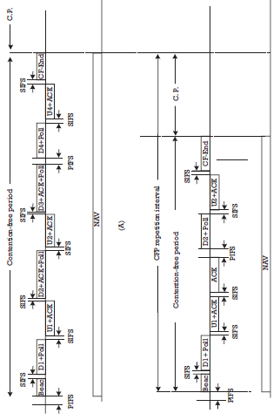
Timing diagram
Point coordinator and station
(b) Station to station

Slide 45
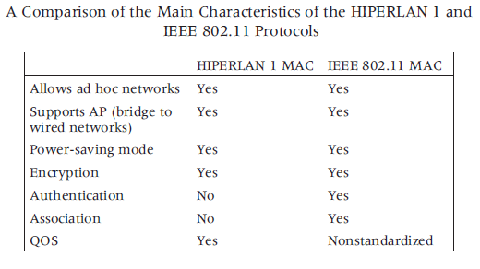

Slide 46
Conclusion
DCF is superior to PCF for short MSDU and low values of BER.
If MSDU length increases, PCF performances are superior, as in packetized services.
MAC has to cooperate with different PHY layers and leave decision-making capabilities to implementers.

